Slide 1

Effects of Changes in Time on Latent Variable Models of a Learning Brain
By Arnold Cheskis Supervised by: Kabir Dabholkar (PhD Student) Omri Barak (Advisor)

Slide 2
Outline
Background
Goal
Motivation
Methods
Results
Conclusions
Challenges
References

Slide 3
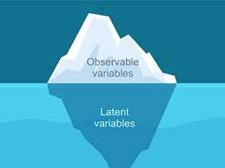
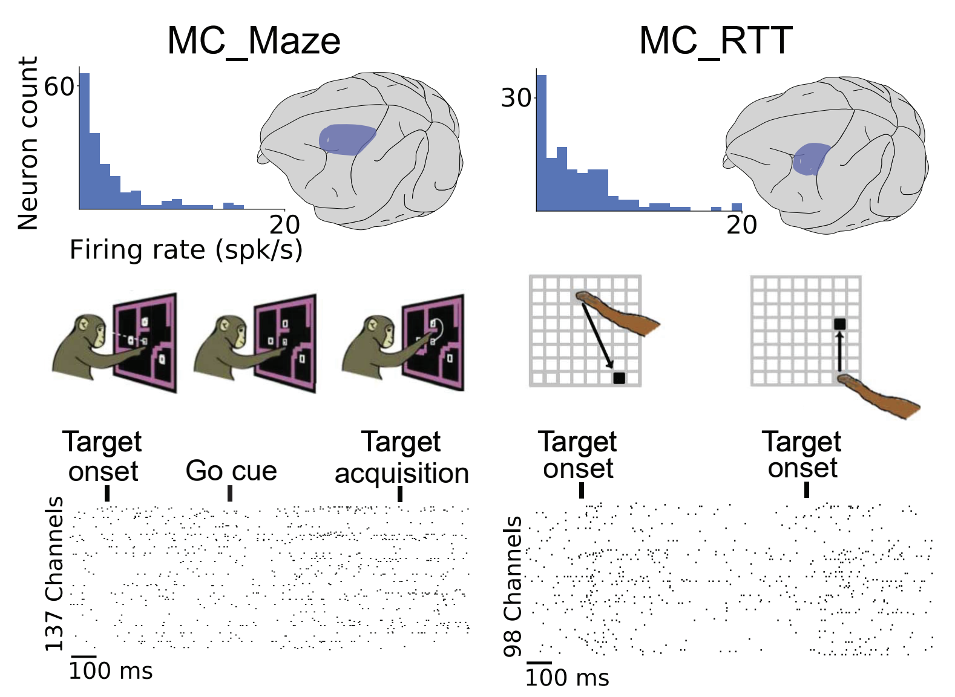
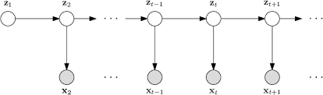
Background
LVM
Brain changes over time
arXiv:2109.04463
Notes:
I’ll start shortly explaining more generally and narrow it down to what I do exactly.
1. Latent variable models (LVMs) are used to capture the dynamics of neural circuits given recordings of signals from the brain – hidden/latent states represent the brain’s inner workings. 2. LVMs assume that the dynamical system remains fixed – given a stimulation the transitions will happen in the same way, not accounting for synaptic changes (brain evolving over time,’learning’)
3. We study the novel scenario of fitting LVMs to a learning brain using a student-teacher setting (in a few slides) – we want the LVM to function like the monkey’s brain

Slide 4
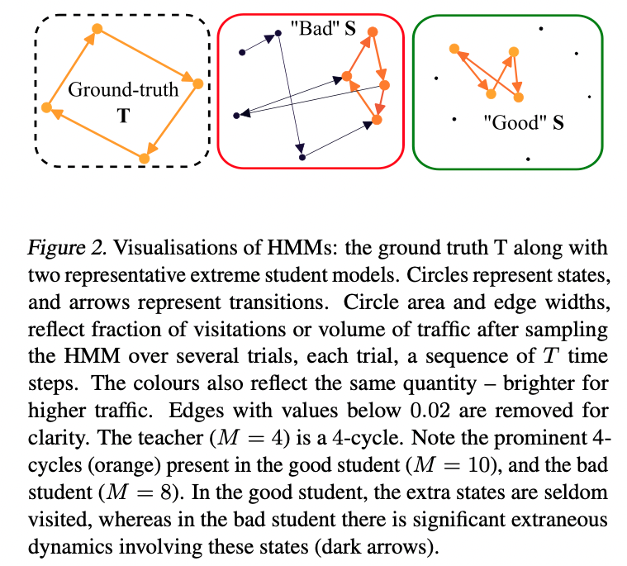
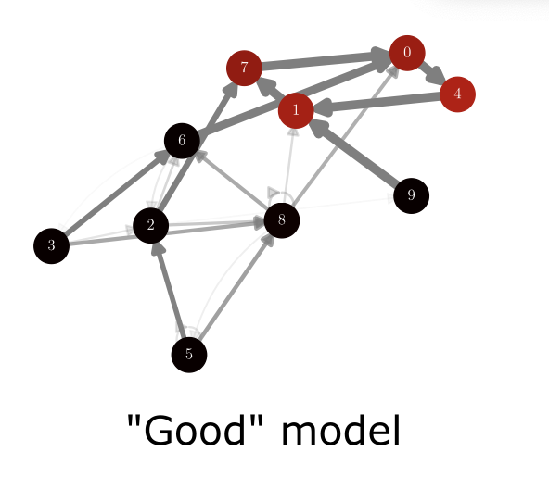
Goal
Understand the behavior of latent models a bit better and see if data from perturbed models can reveal something new (how models behave) or even help discriminate “bad” models⁽¹⁾ based on their performance.
(1) arXiv:2405.14425
Notes:
Explain what ”bad” means.

Slide 5
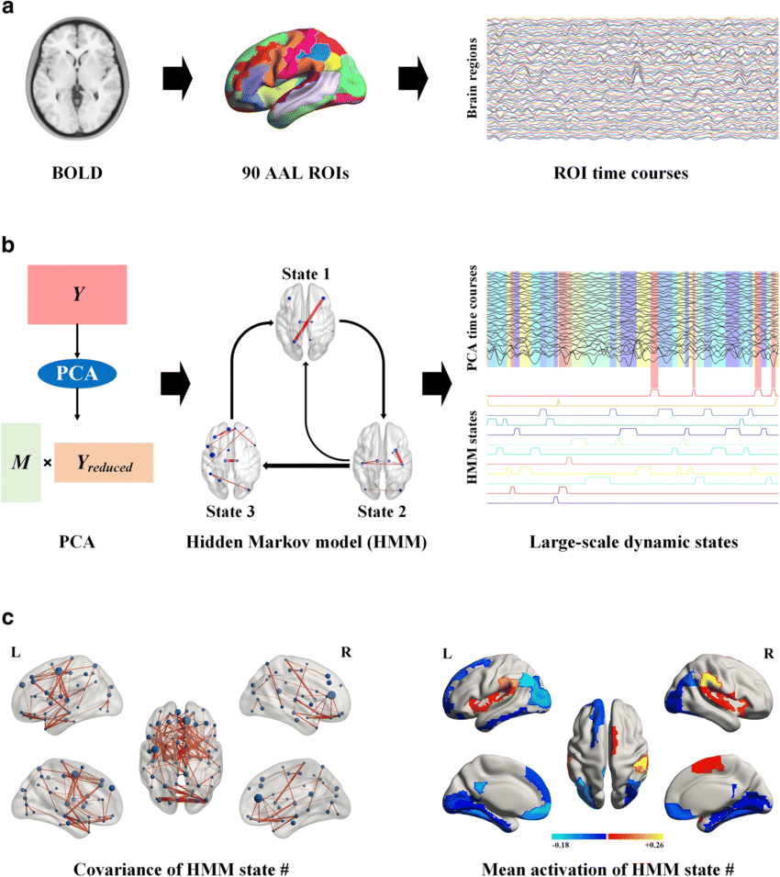
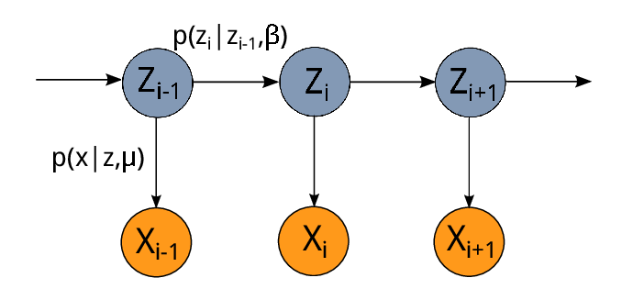



Why do this?
$$t_{0}$$
$$t_{1}$$
$$t_{2}$$
Understanding latent variable models (LVMs) better →
Finding better methods to discriminate and find models that more accurately represent the ground truth →
Create better models to represent the inner workings of the brain →
Understand the brain better.

Slide 6
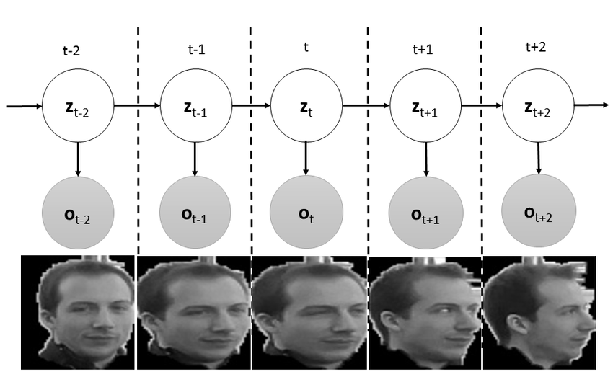
Student – Teacher settings
Teacher
aka ”ground truth”
Student
Notes:
A couple of words. Will elaborate more on this in the next slides.

Slide 7
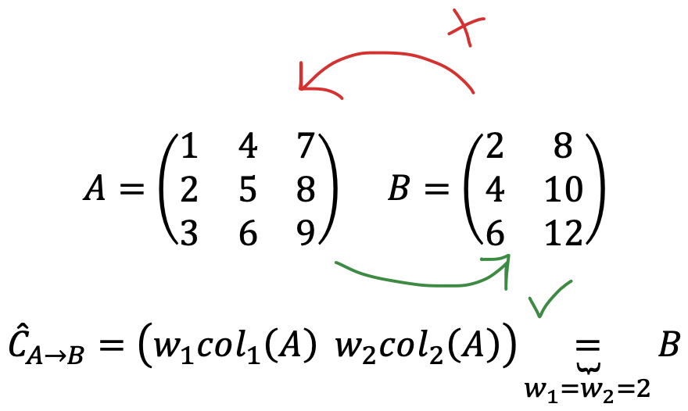
Decoding and Co-smoothing
Likelihood only shows how close the models' output is to the ground truth without telling us anything about their inner structure (which is what we have when we work with emissions from the brain).
Using decoding, we can infer the similarity of the latent variables
Notes:
A couple of words. Will elaborate more on this in the next slides.

Slide 8
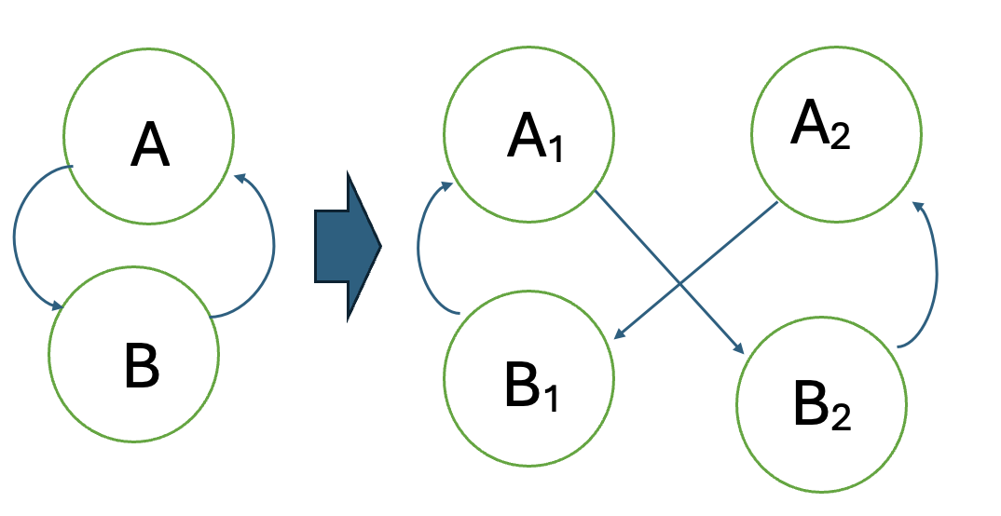





Artificial students
Student model that performs like the teacher, and overfit during training
Transition matrix <Kronecker> Shift matrix
Notes:
In addition to randomly initiated students, I created models artificially as well.

Slide 9

Changes over time?
How do models perform DURING the training, in each epoch?
How will the co-smoothing and the decoding scores change before and after convergence/over-fitting?
What can the performance of models on perturbed models teach us? What happens during the fitting of trained models to perturbed models?
What if we don’t give enough time for the models to converge during the training?

Slide 10
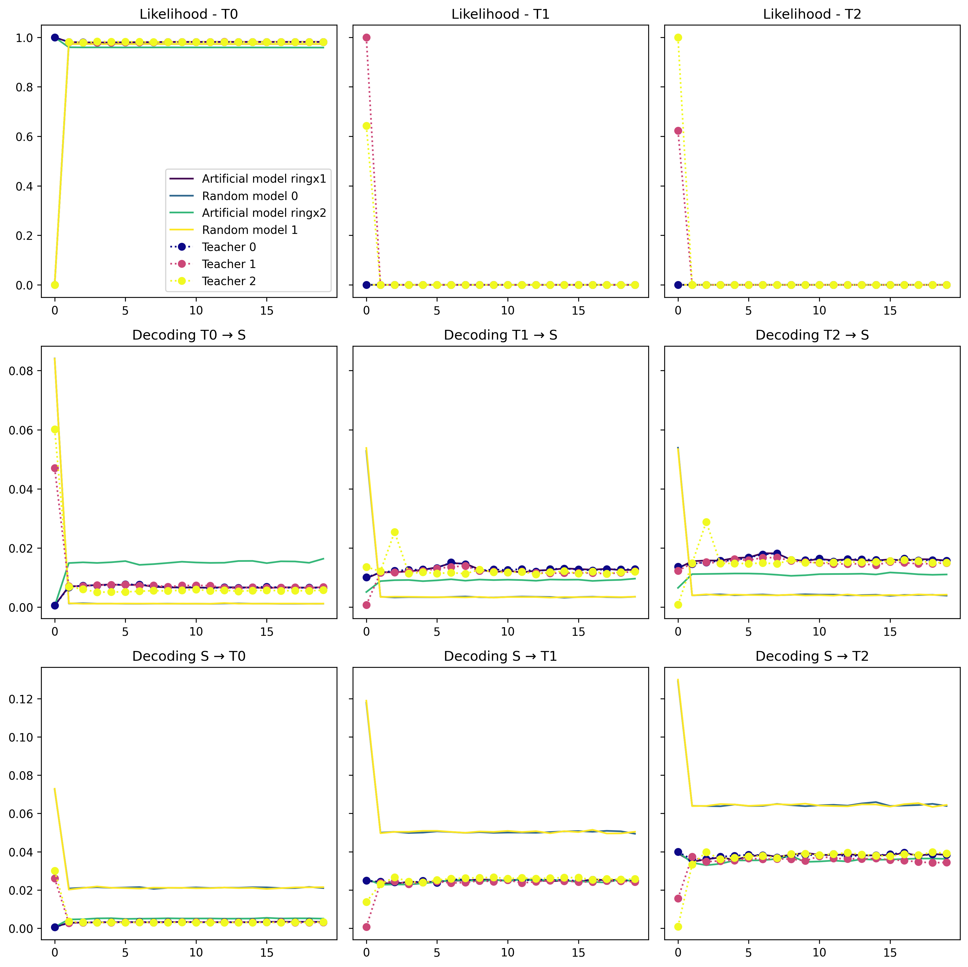
Results – Changes during fitting to T0 20Epochs 250Iter 100Timesteps 1000Trials expectation maximization (fit_em)
Notes:
EMISSION_DIM = 5
TRUE_NUM_STATES = 10

Slide 11
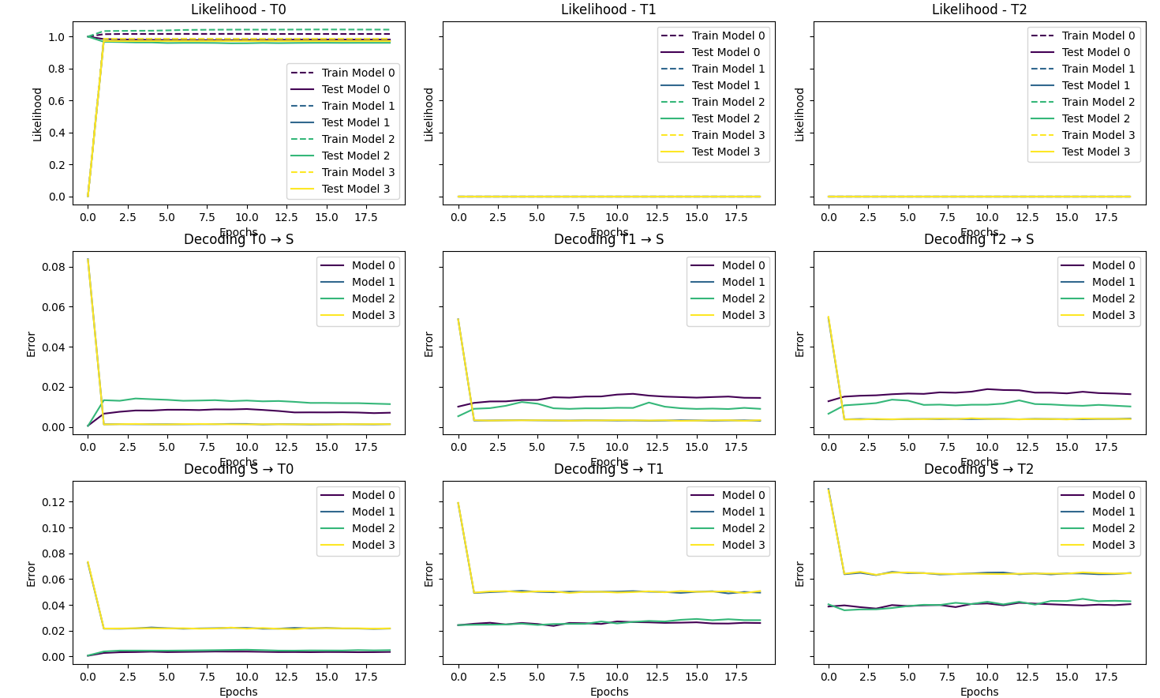
Closer look on the ”bad” models

Slide 12
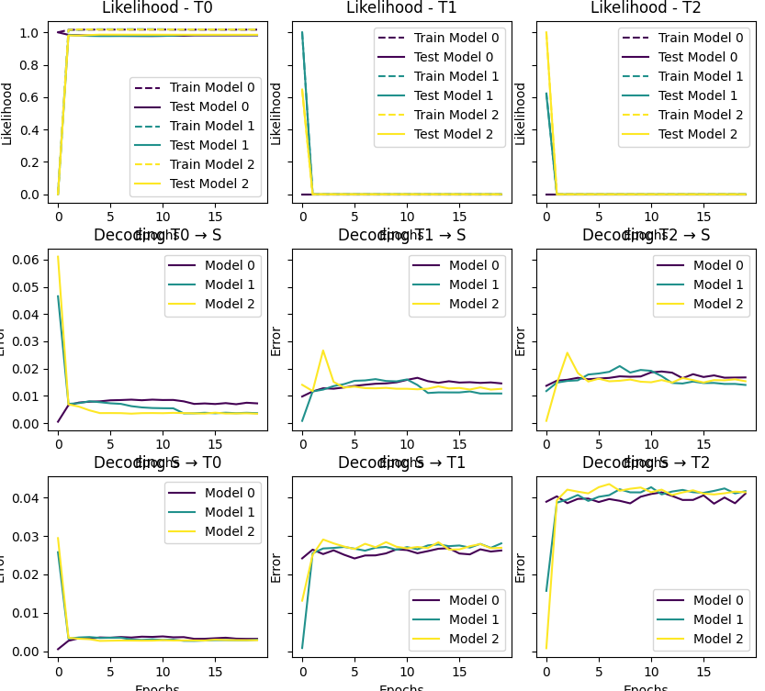
Closer look on the “good” models
Notes:
The bump, may be explained by over fitting.

Slide 13
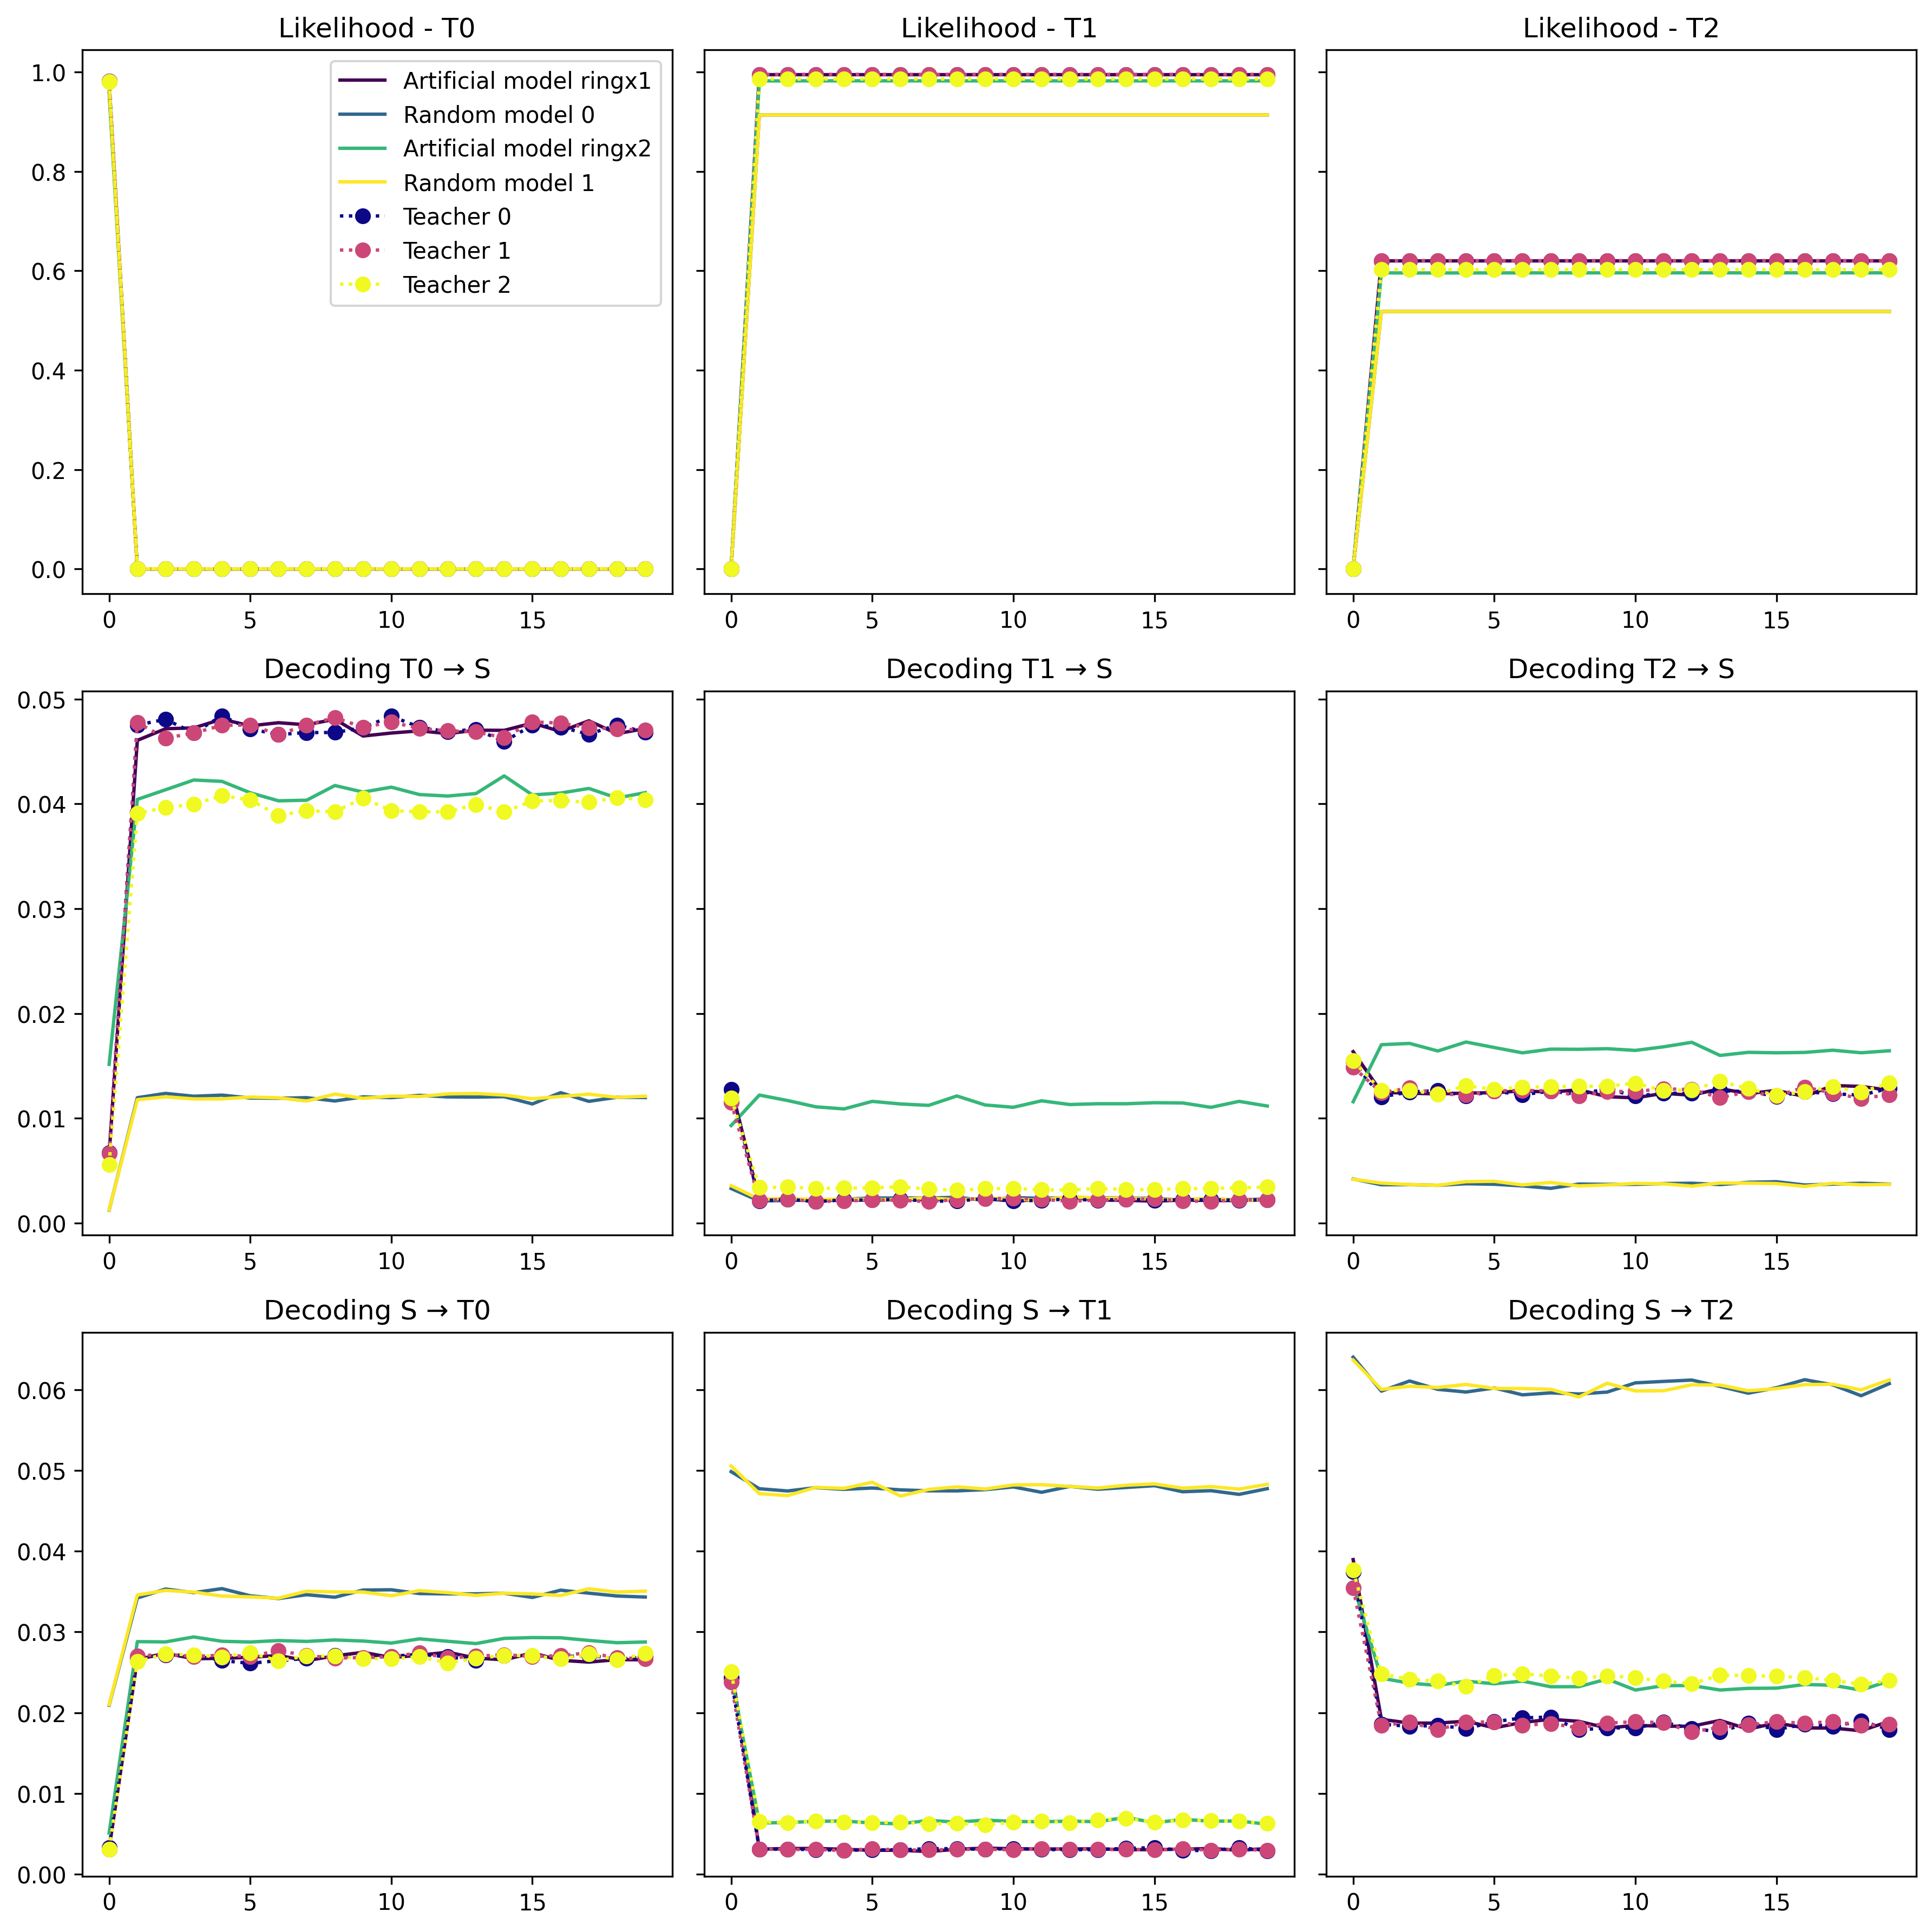
T0-fitted models fitted again on T1 20 Epochs with expectation maximization (fit_em)
Notes:
When models are similar – perturbations small – and a lot of data (with little not working) – can discriminate

Slide 14
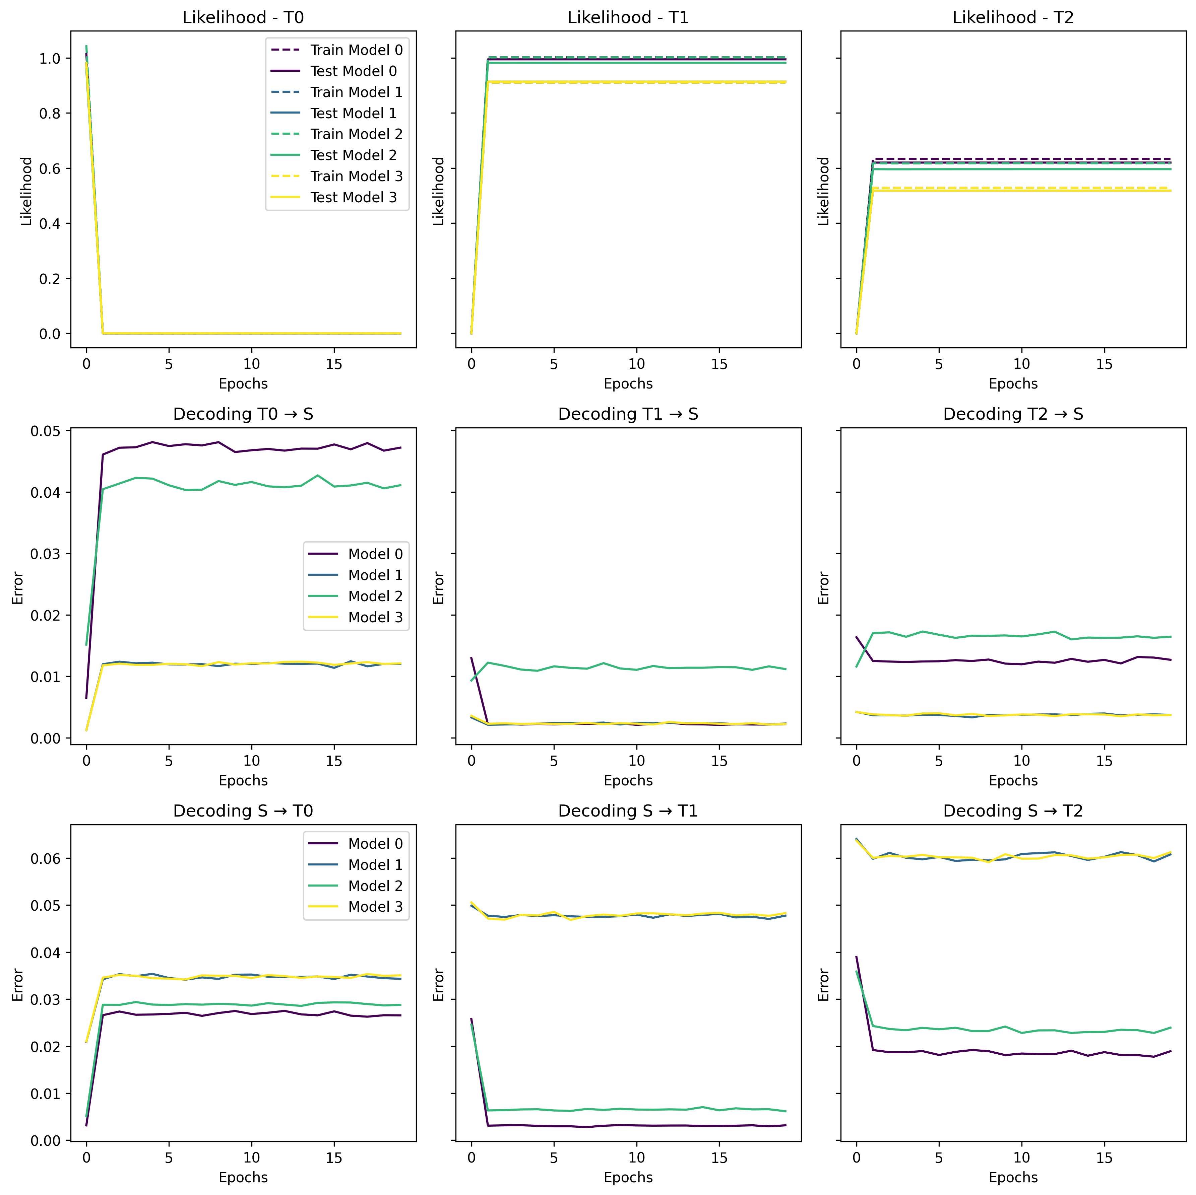
Closer look on the ”bad” models

Slide 15
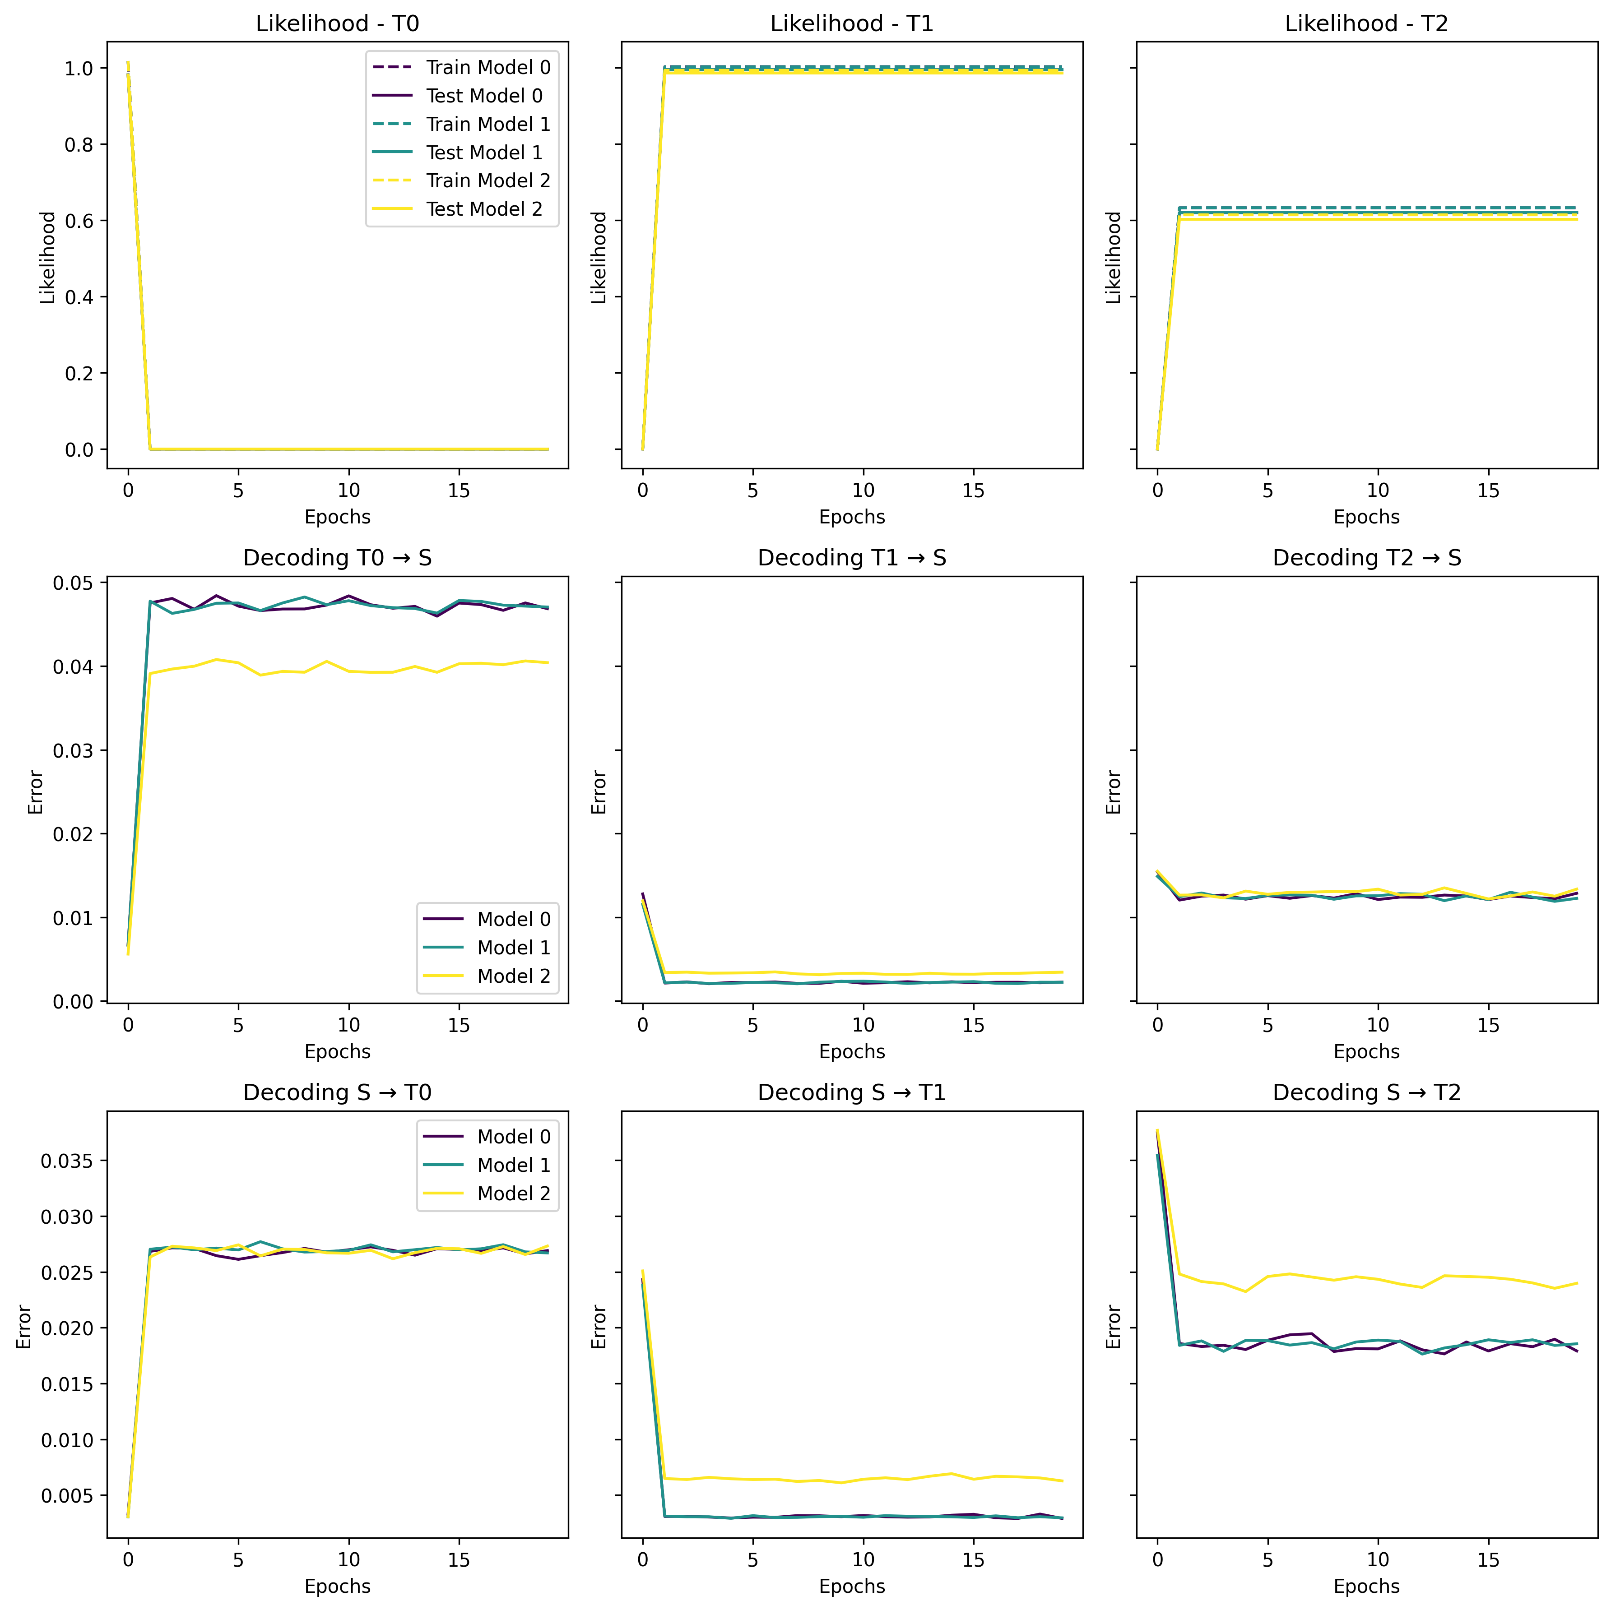
Closer look on the “good” models
Notes:
The bump, may be explained by over fitting?

Slide 16
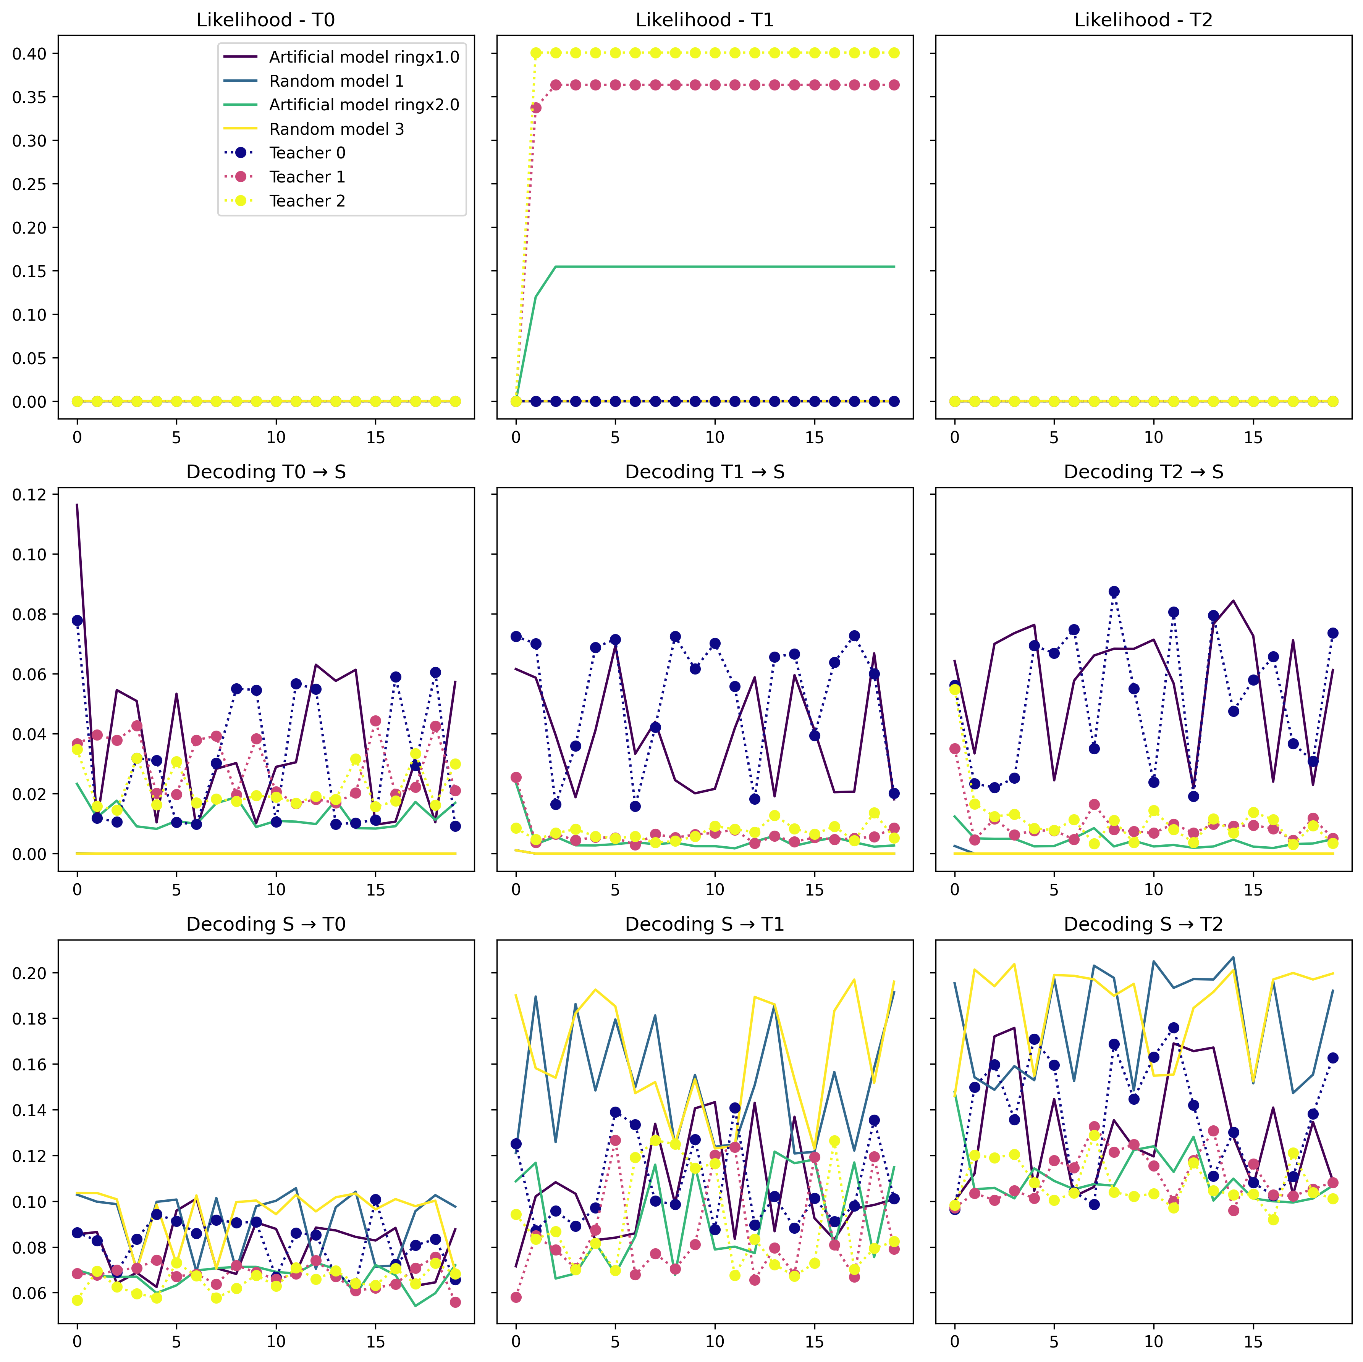
Fitting to T1 different run- unknown parameters
Notes:
Here I did expect improvement based on Kabir’s paper

Slide 17
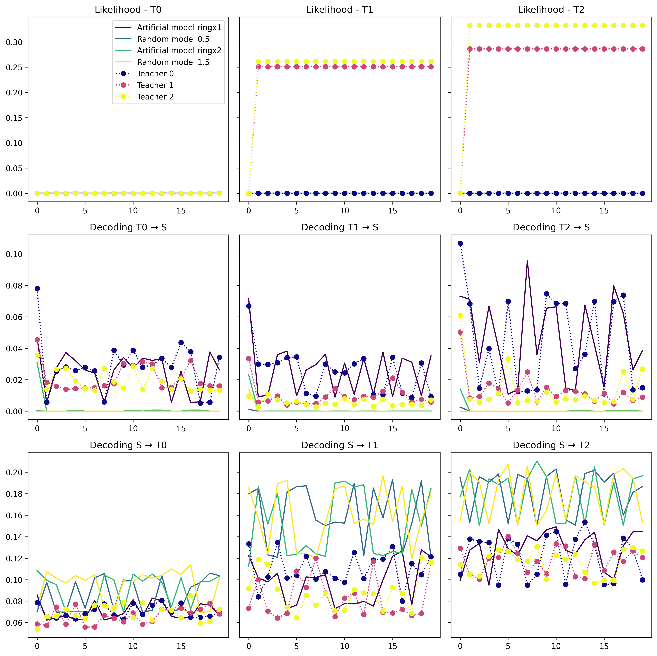
Fitting to T2 different run- unknown parameters
Notes:
Here I did expect improvement based on Kabir’s paper

Slide 18
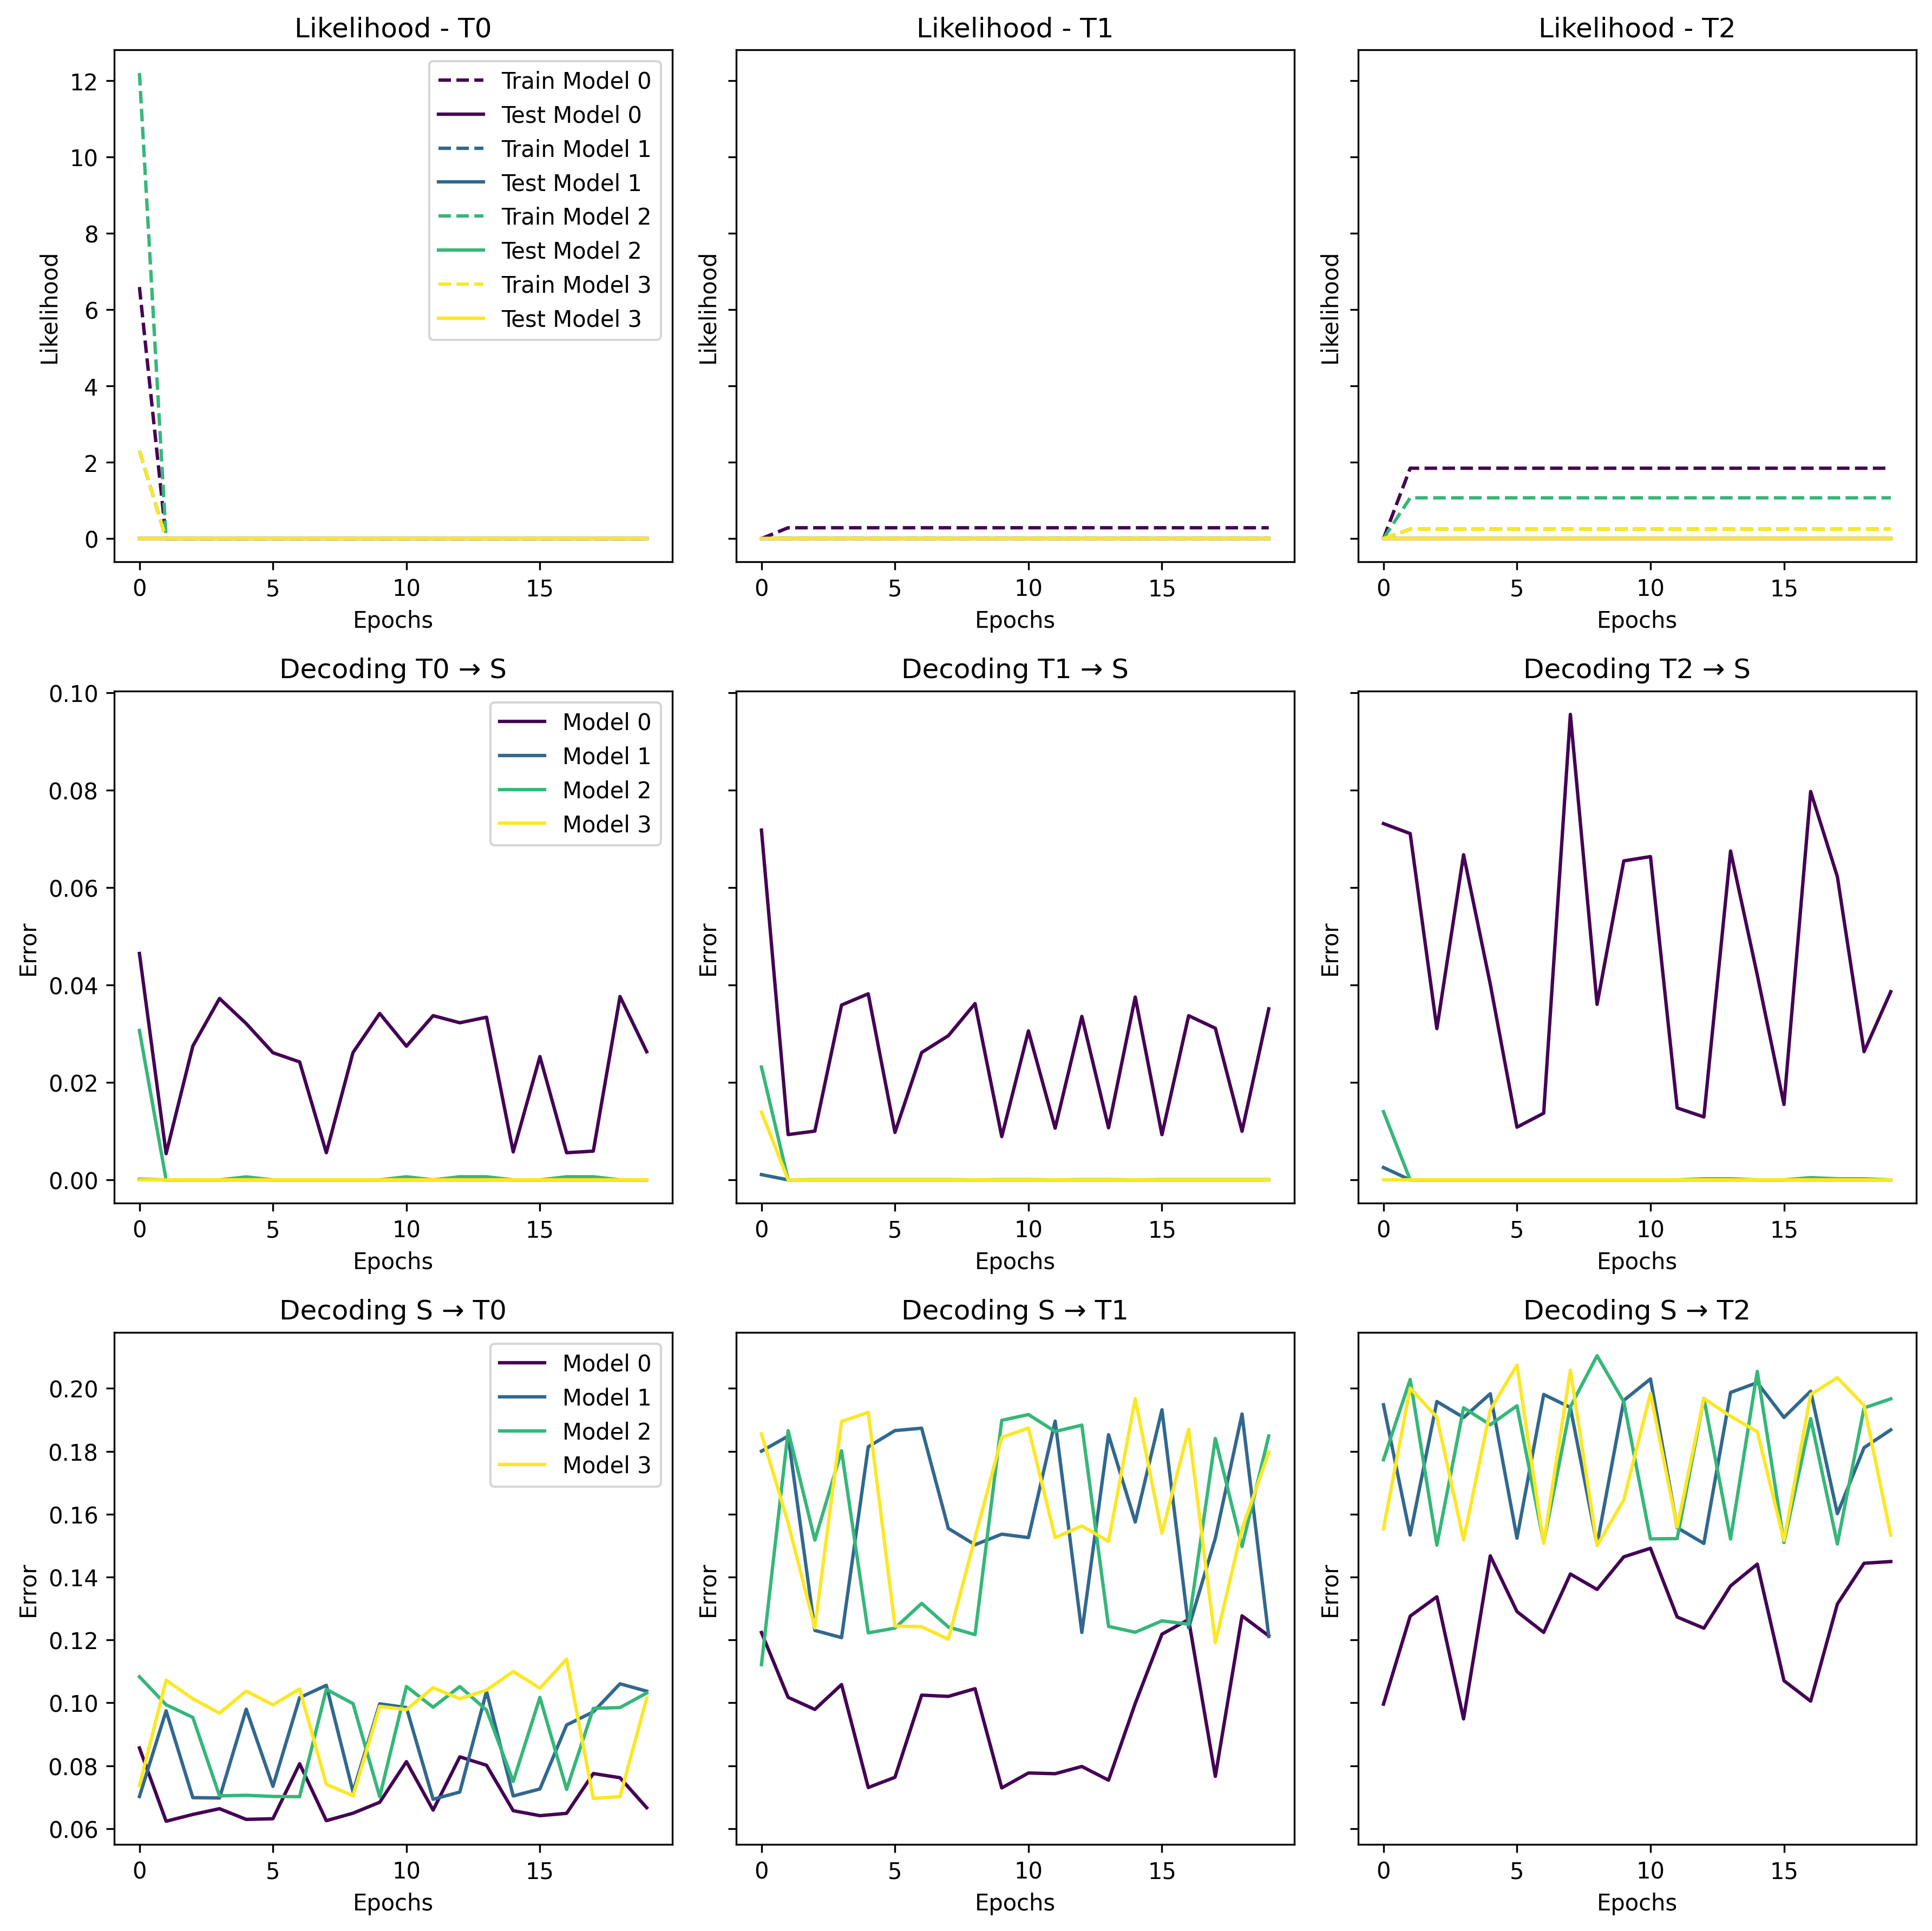
Closer look on the ”bad” models

Slide 19
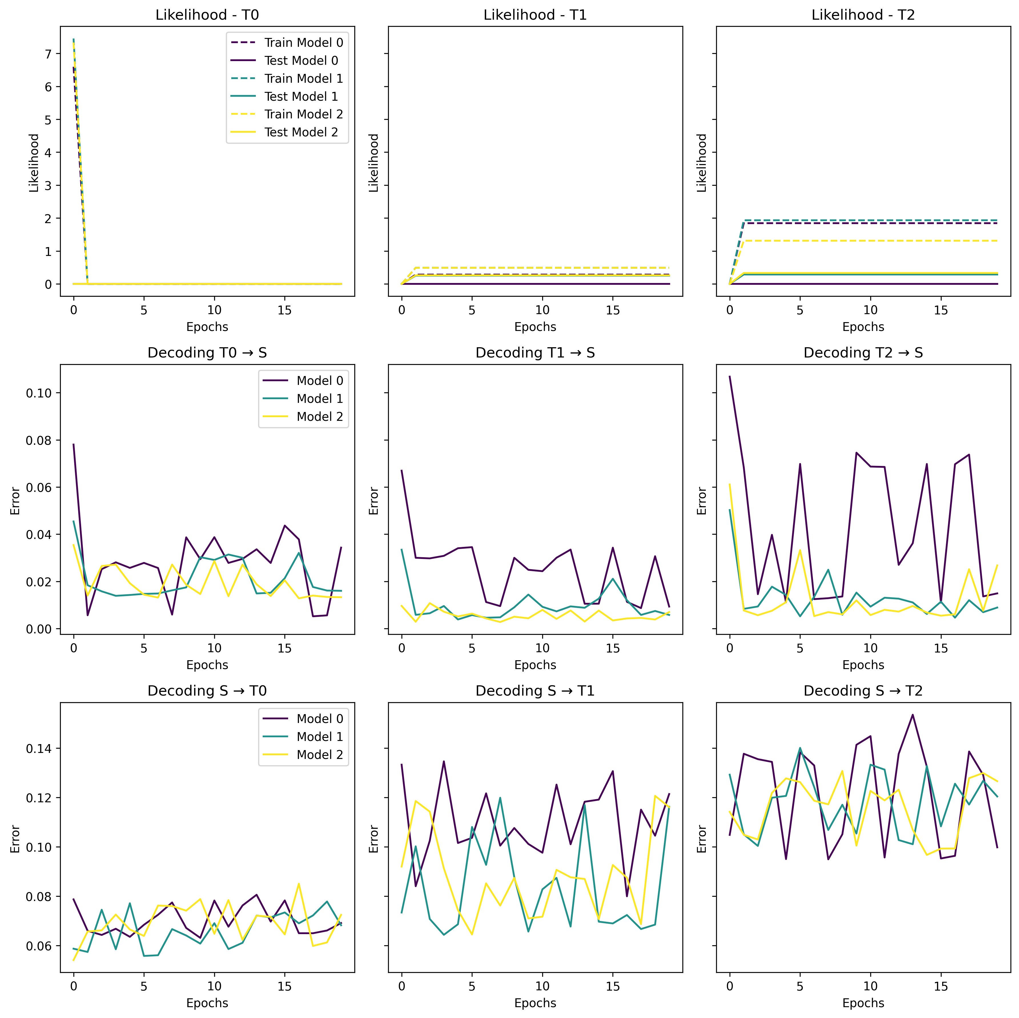
Closer look on the “good” models

Slide 20
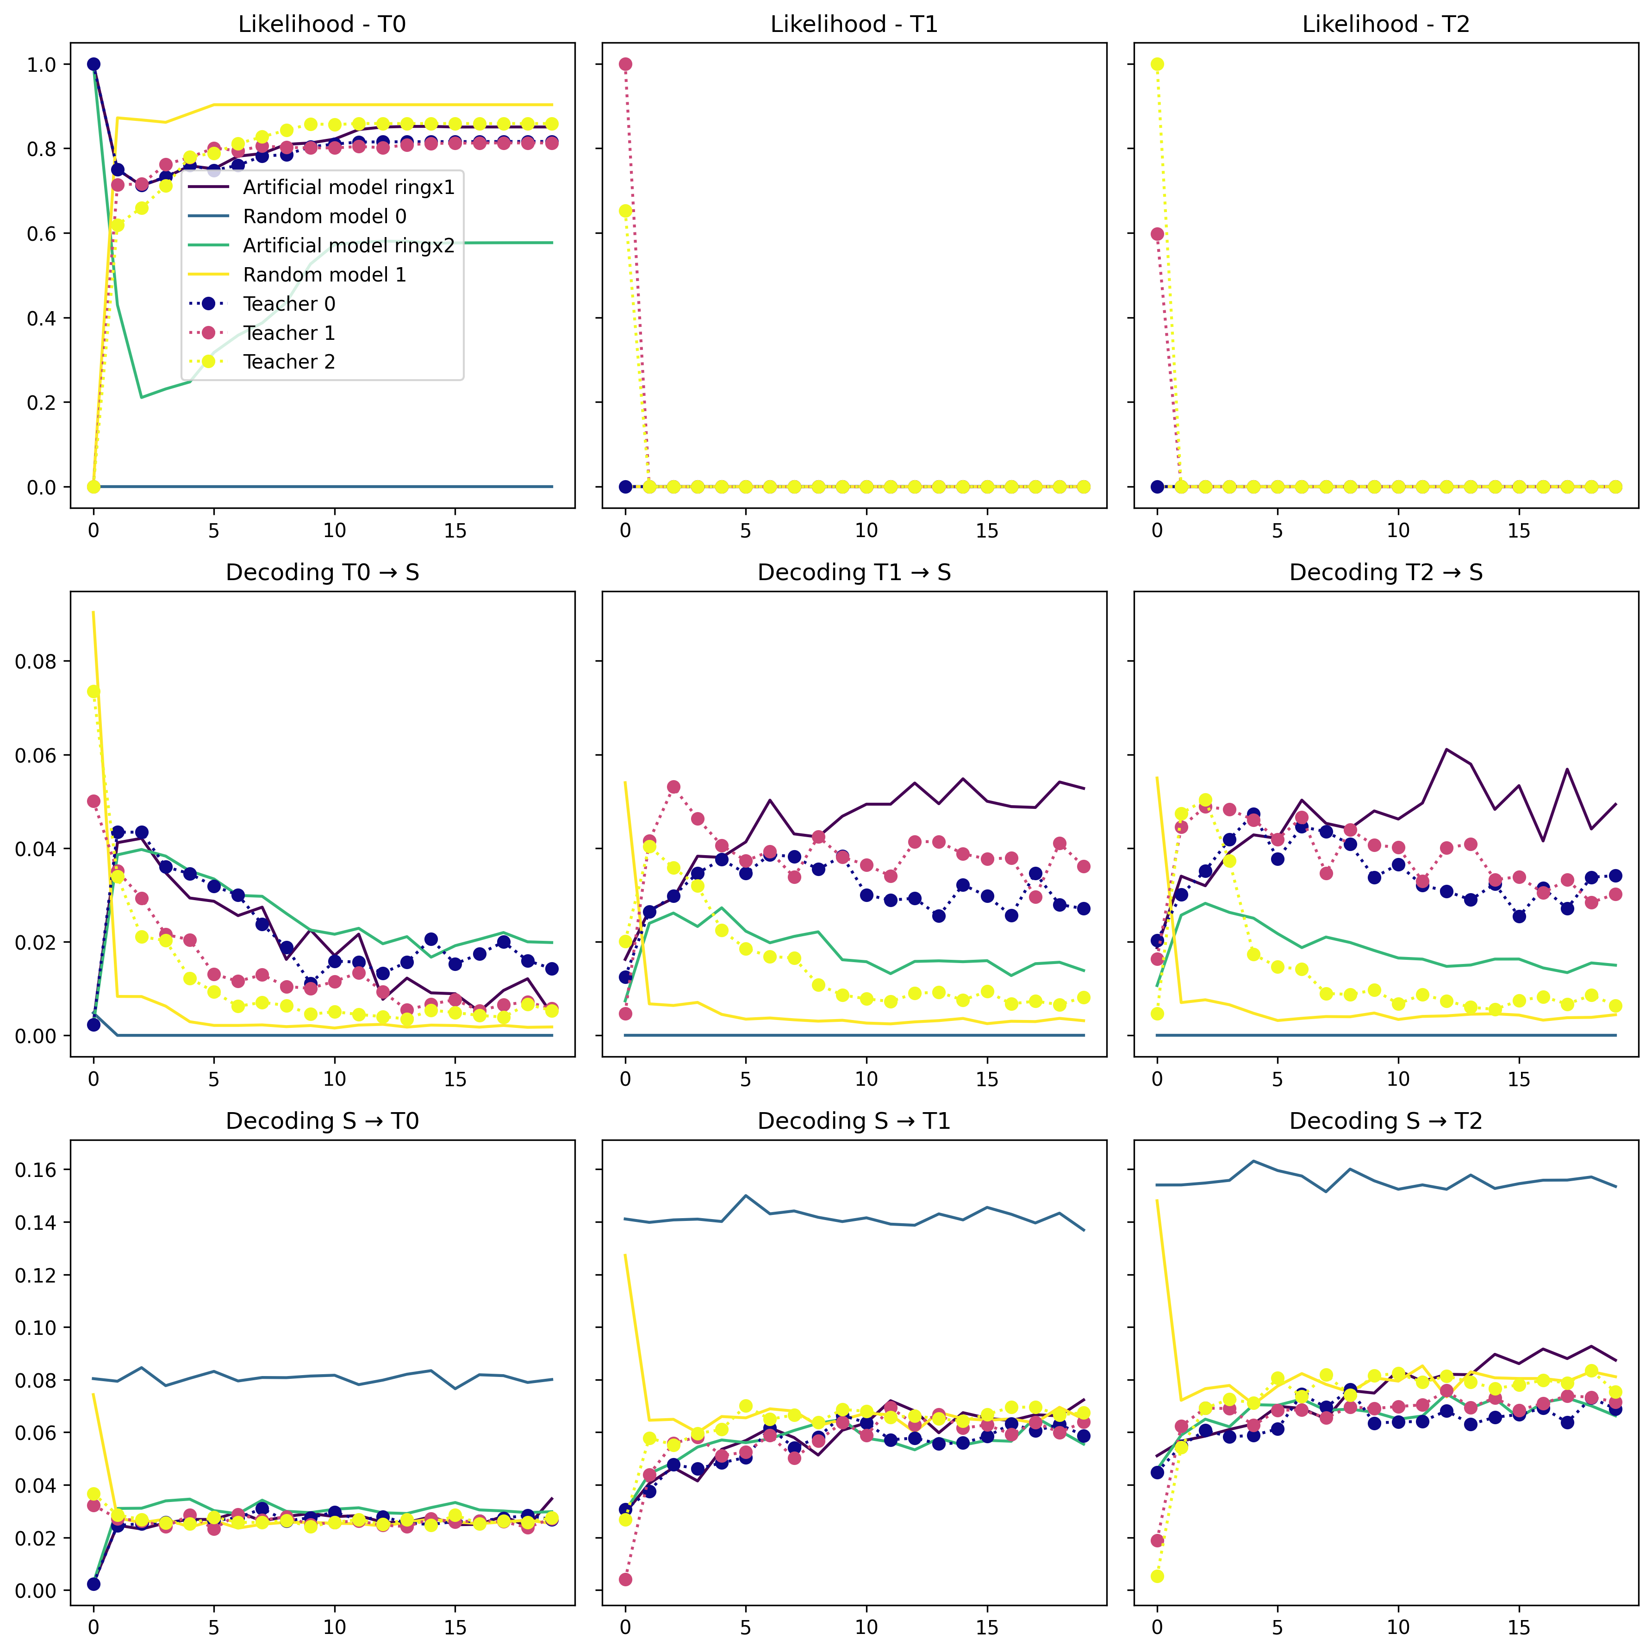
Same run with less data –T0 fit 20Epochs_30Iter_50Timesteps_100Trials

Slide 21
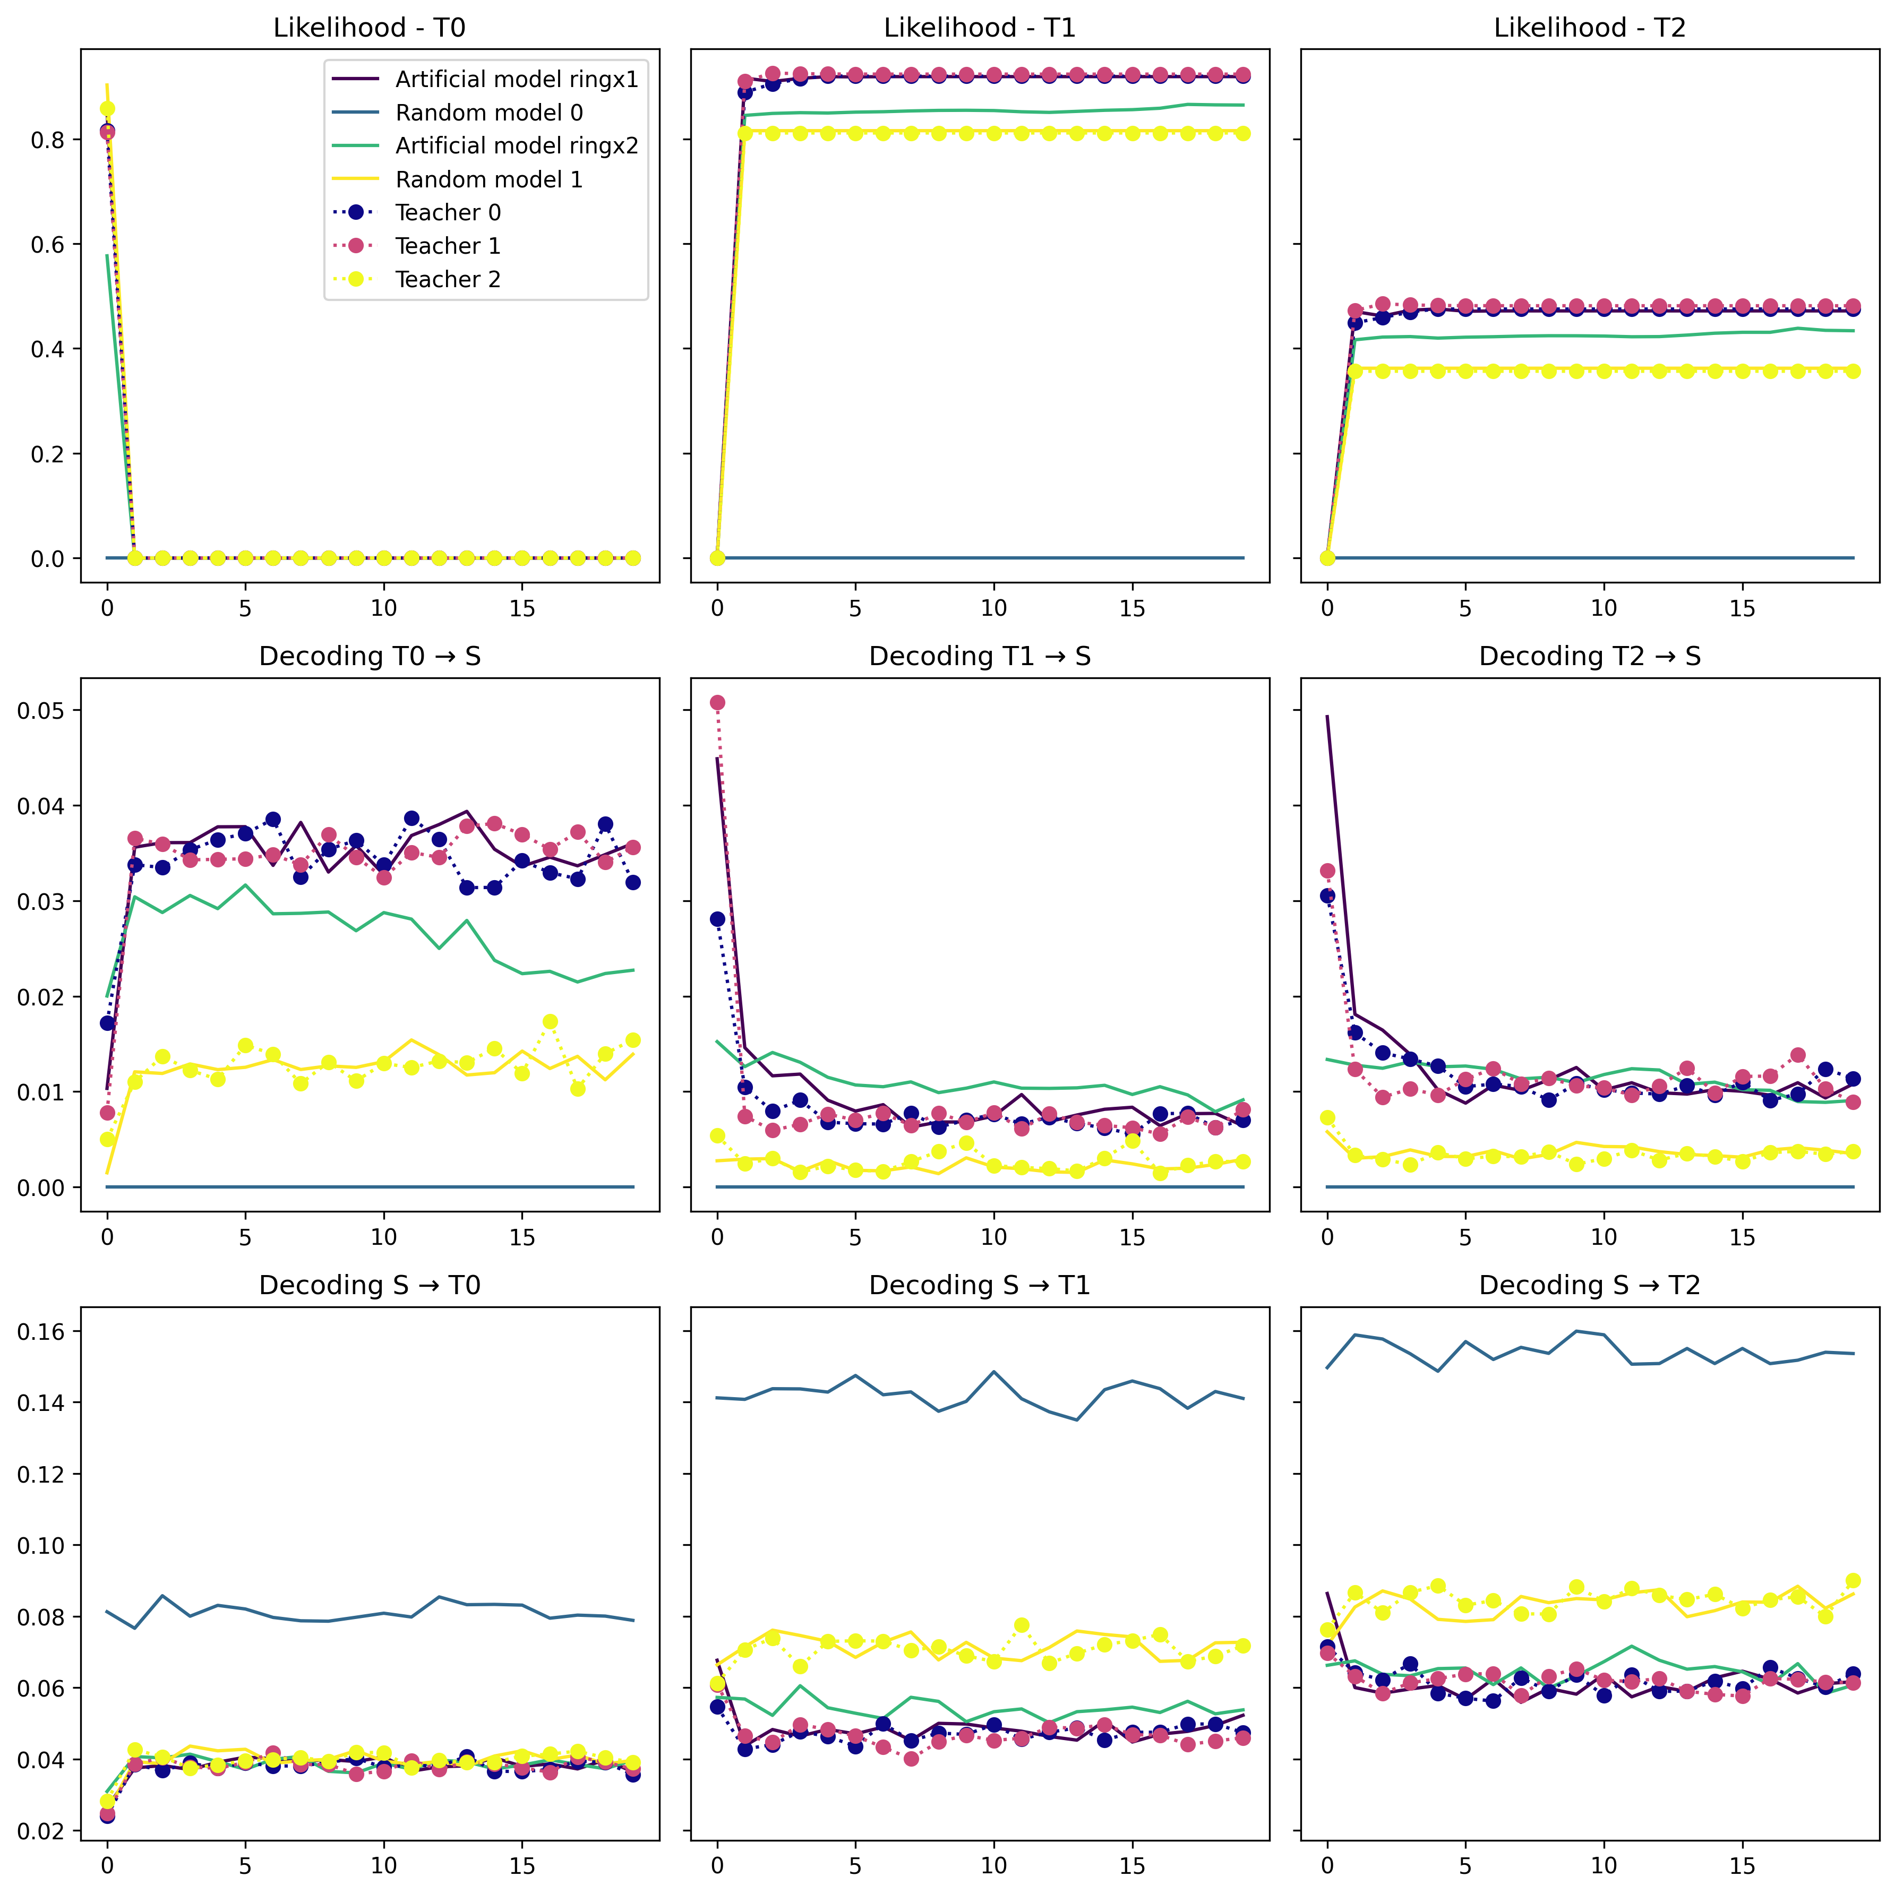
Same run with less data –T1 fit 20Epochs_30Iter_50Timesteps_100Trials

Slide 22
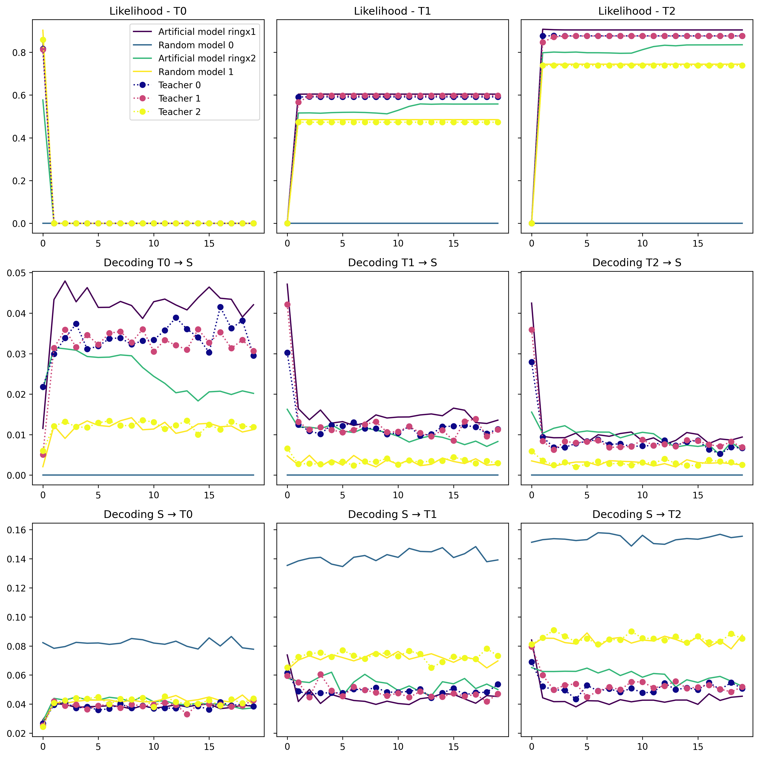
Same run with less data –T2 fit 20Epochs_30Iter_50Timesteps_100Trials

Slide 23
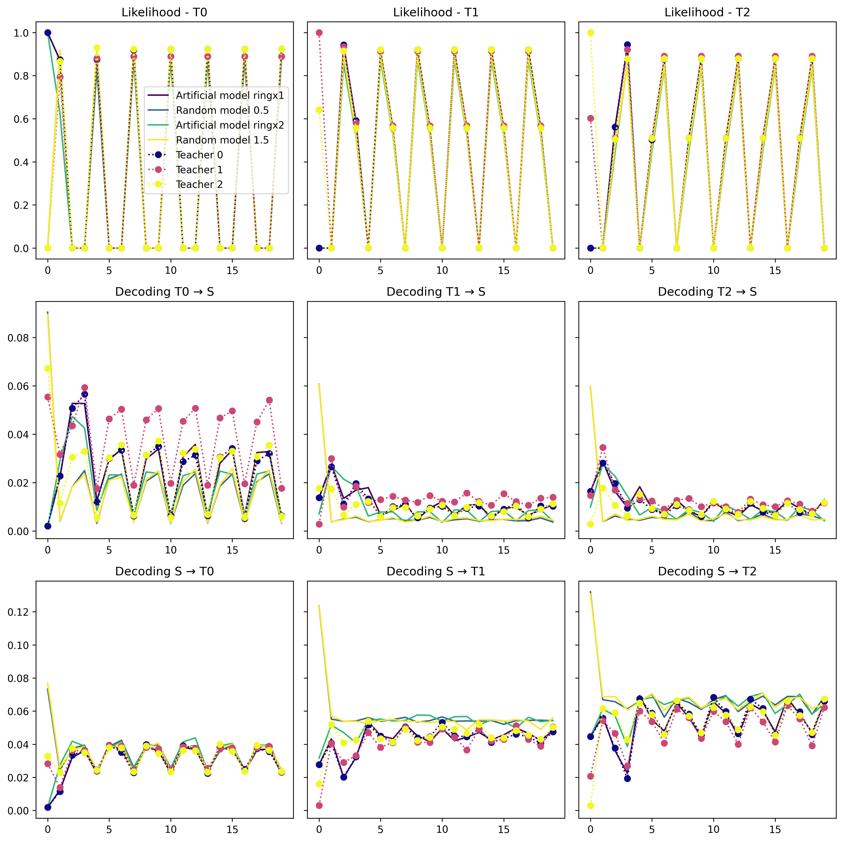
Fitted each epoch on a different teacher 20Epochs 250Iter 100Timesteps 100Trials fit_em
Notes:
Here I did expect improvement based on Kabir’s paper

Slide 24
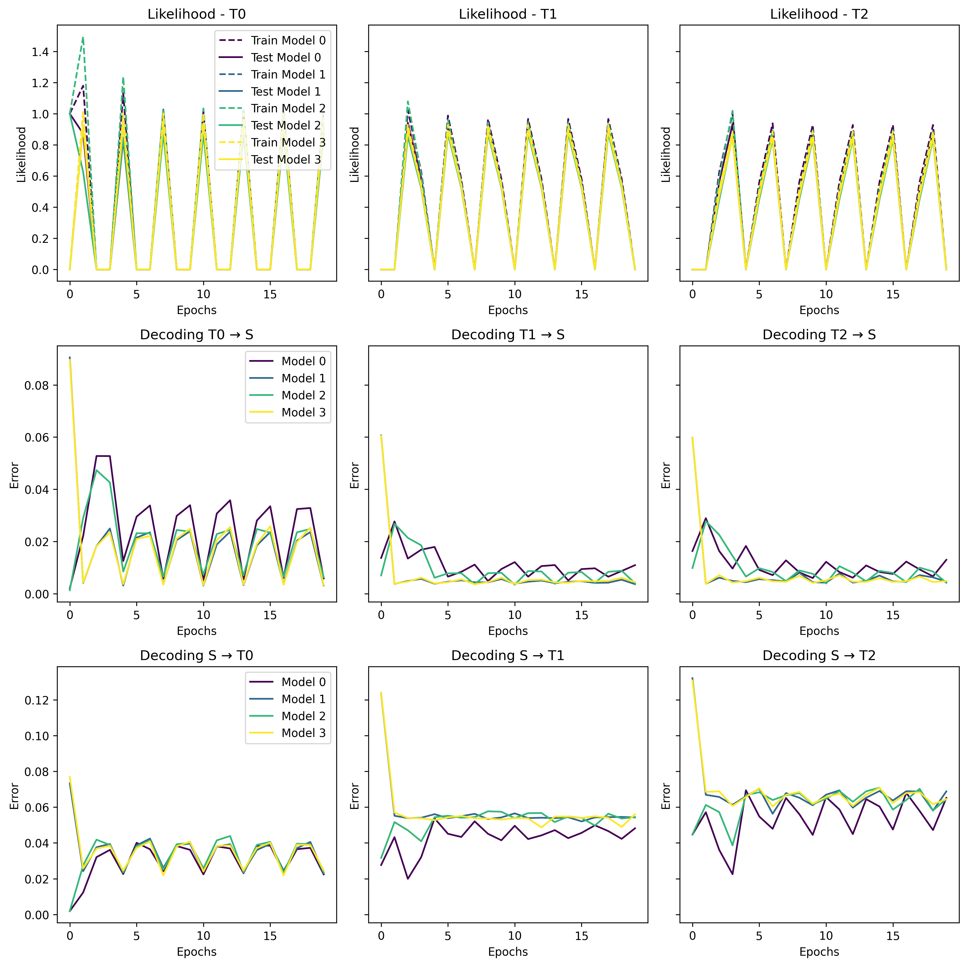
Closer look on the ”bad” models
Notes:
Here I did expect improvement based on Kabir’s paper

Slide 25
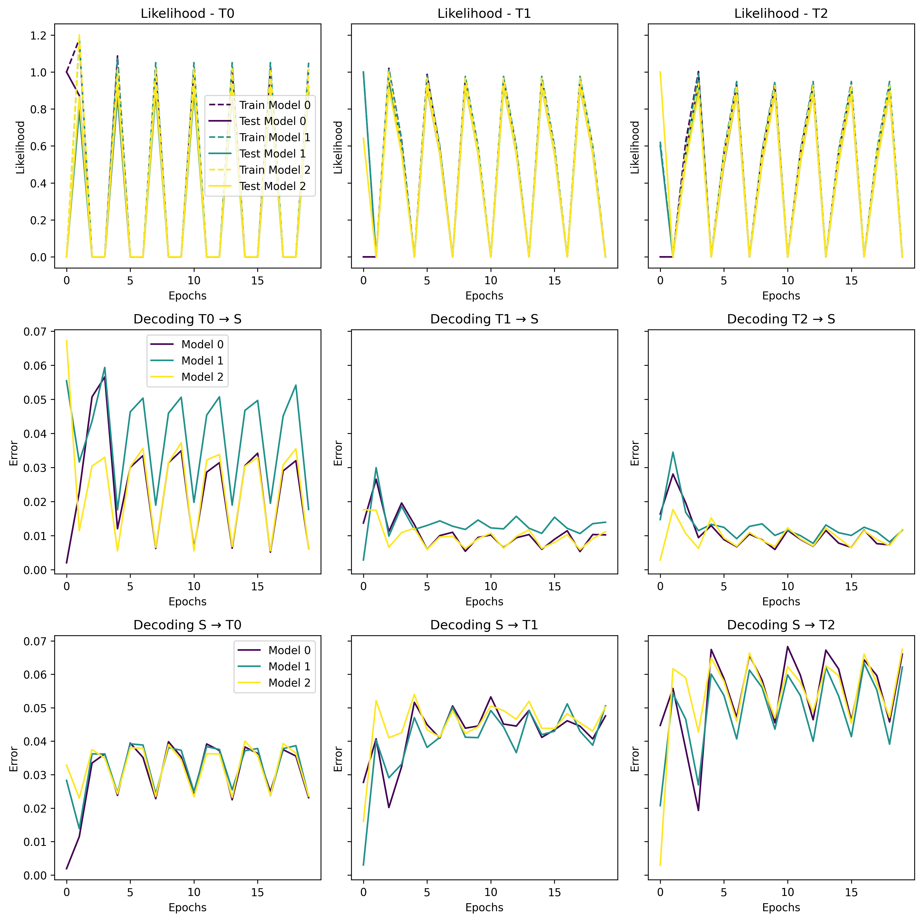
Closer look on the “good” models
Notes:
Here I did expect improvement based on Kabir’s paper

Slide 26
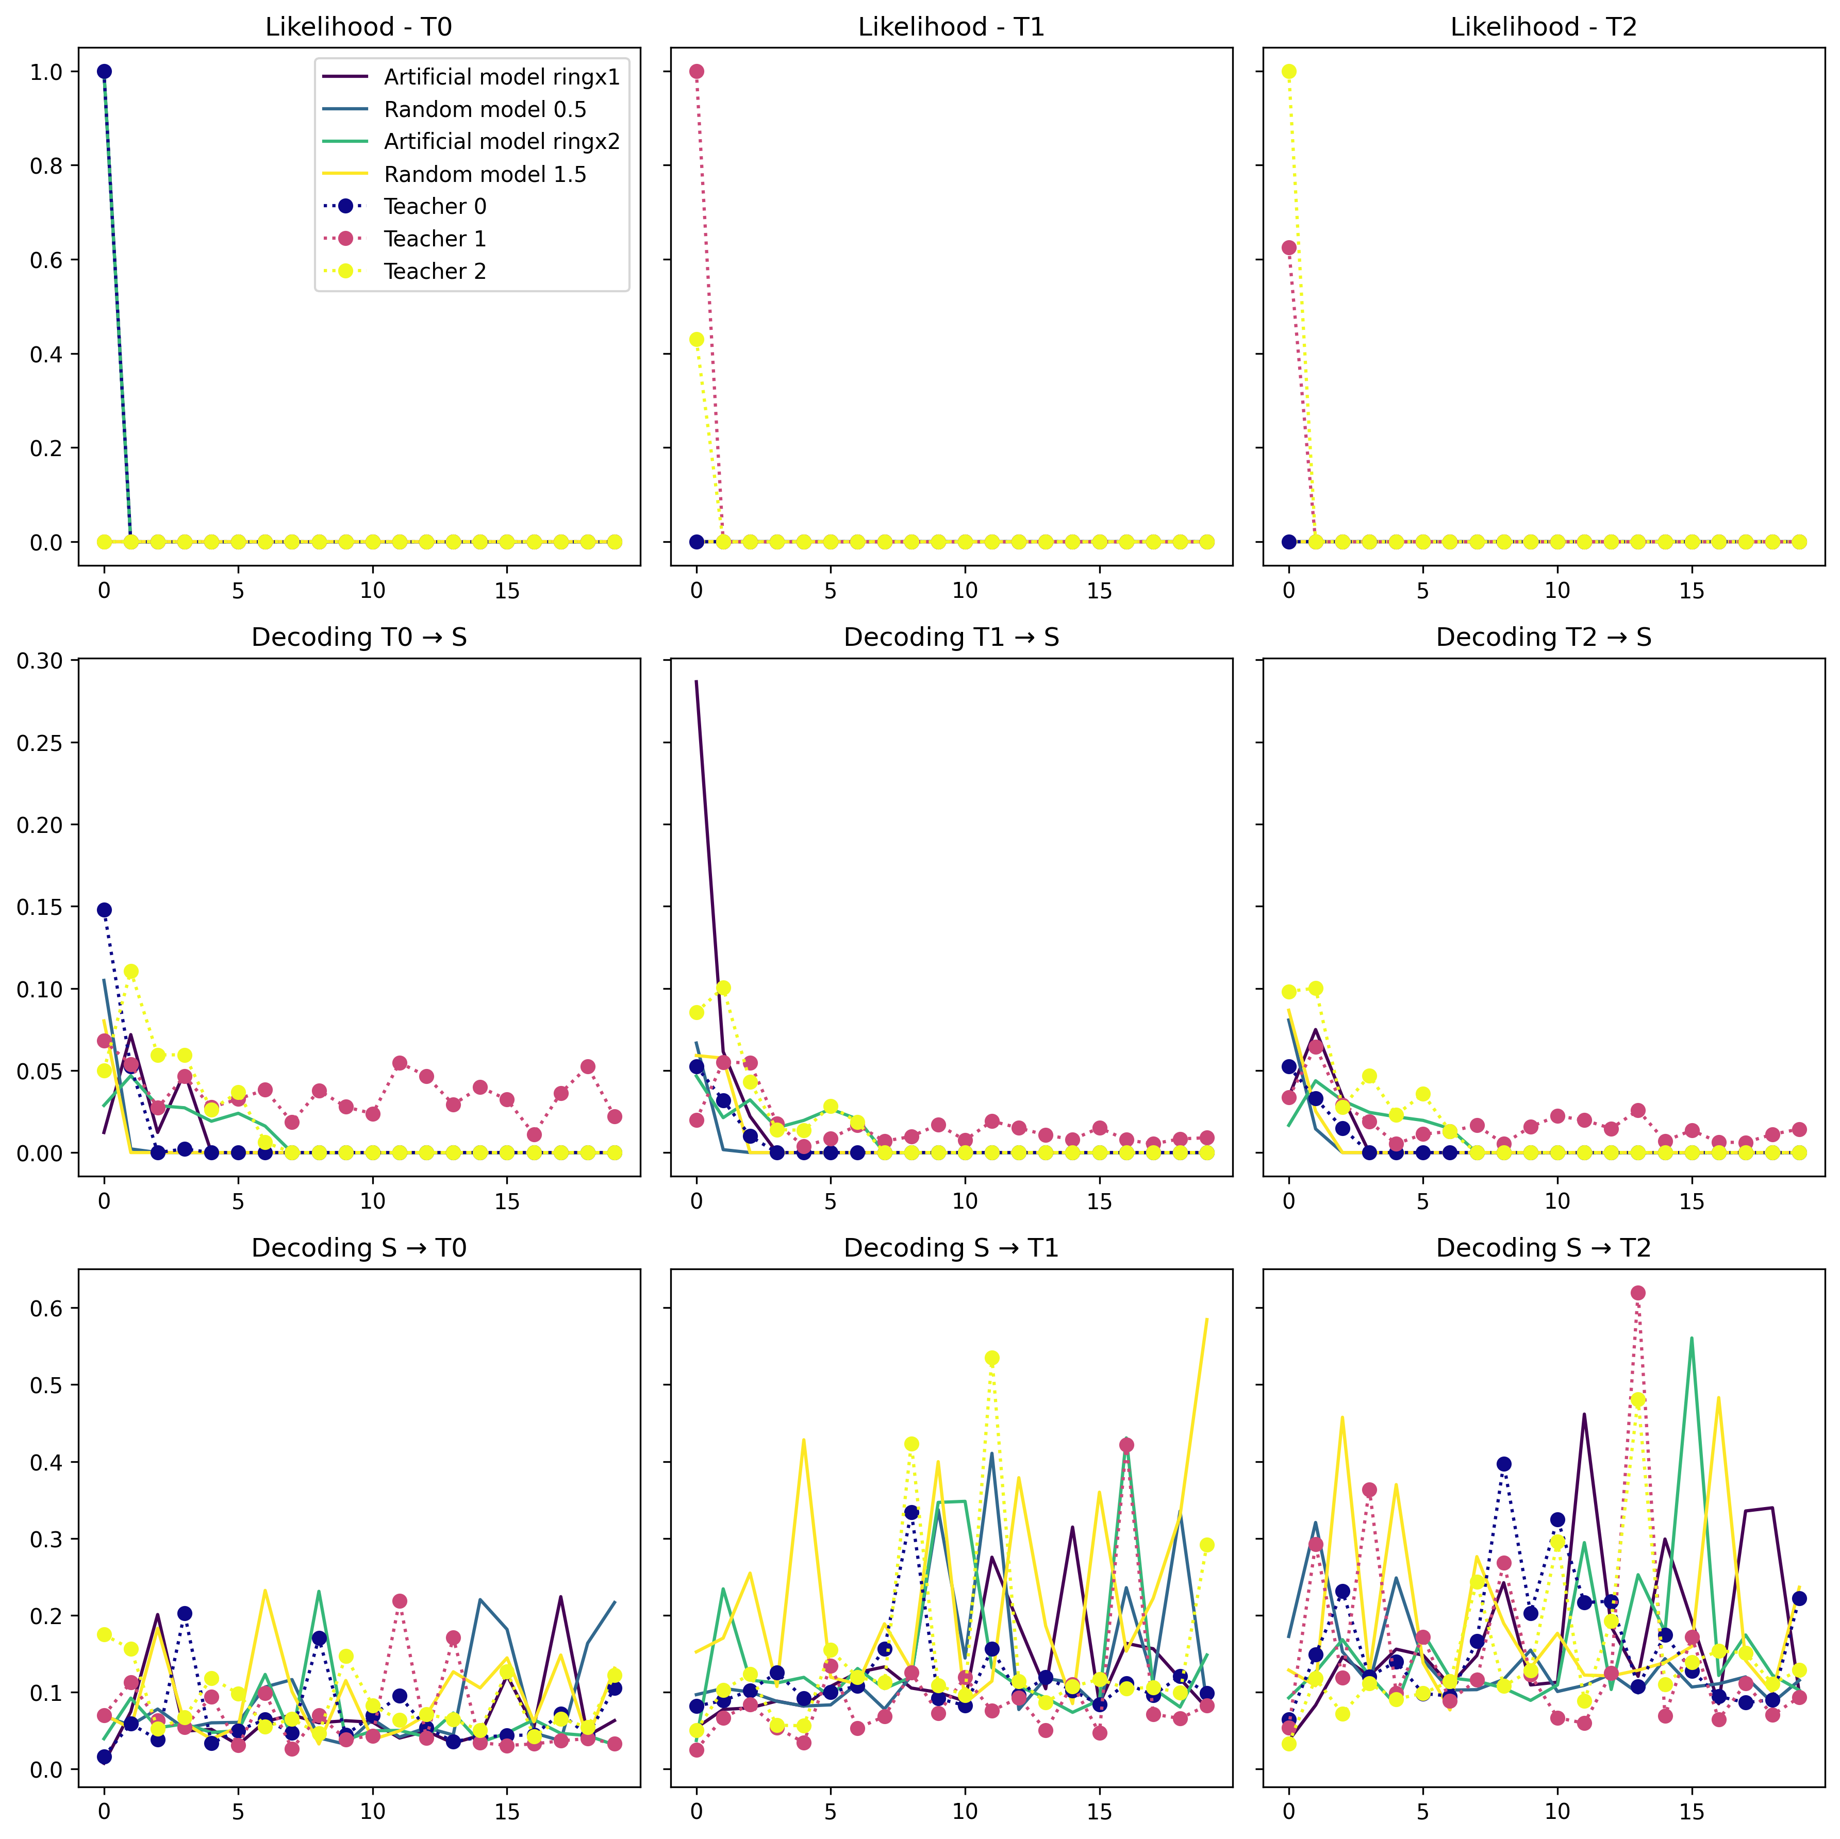
Overly rapid transitions Multi-T-fit_20Epochs_10Iter_10Timesteps_10Trials_SGD=False
Notes:
Here I did expect improvement based on Kabir’s paper

Slide 27
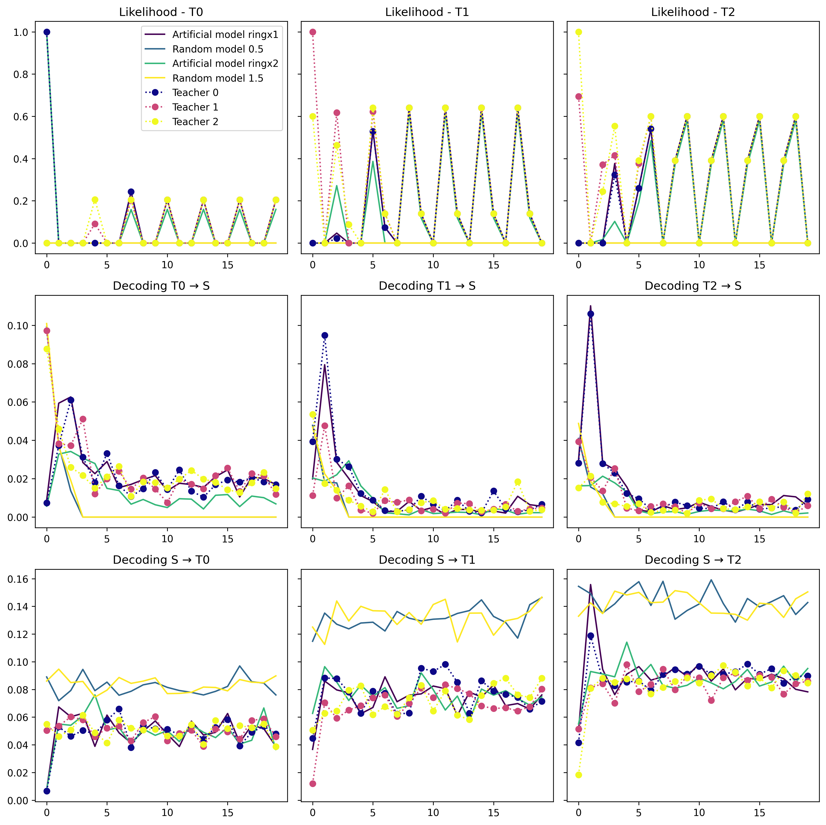
Balanced parameters 20Epochs 30Iter 50Timesteps 10Trials
Notes:
Here I did expect improvement based on Kabir’s paper

Slide 28
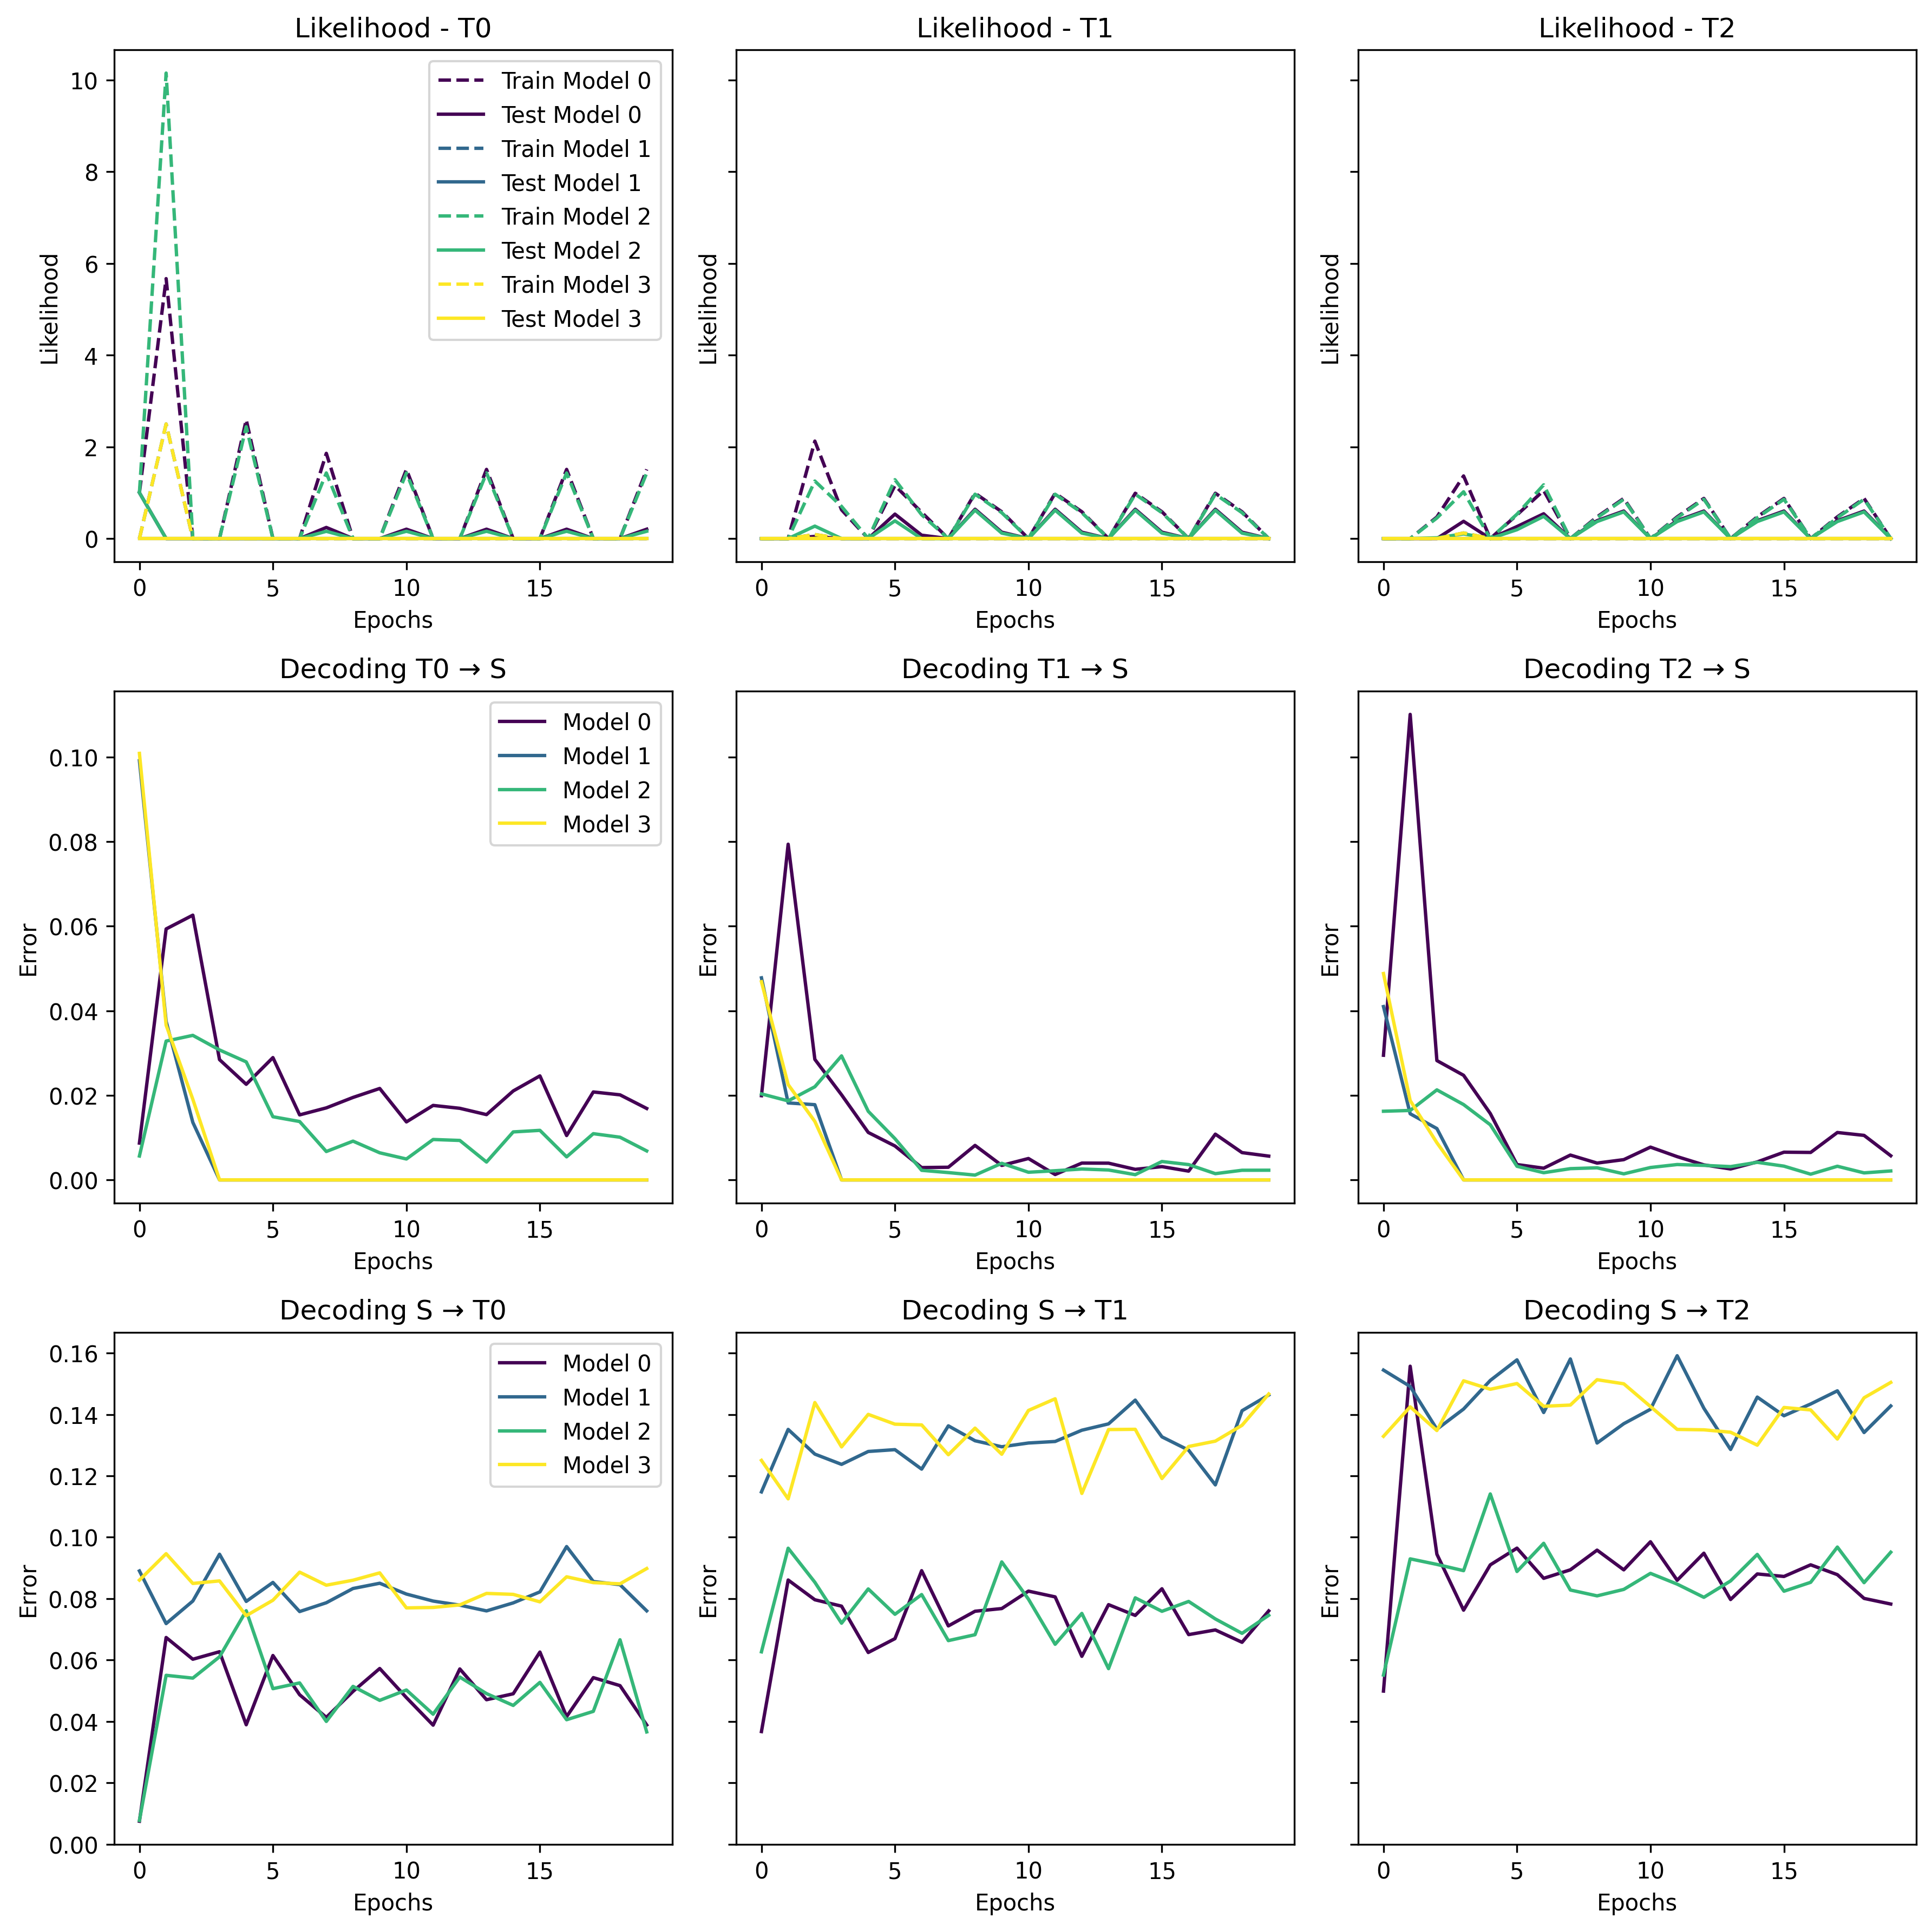
Closer look on the “bad” models
Notes:
Here I did expect improvement based on Kabir’s paper

Slide 29
Closer look on the “good” models
Notes:
Here I did expect improvement based on Kabir’s paper

Slide 30
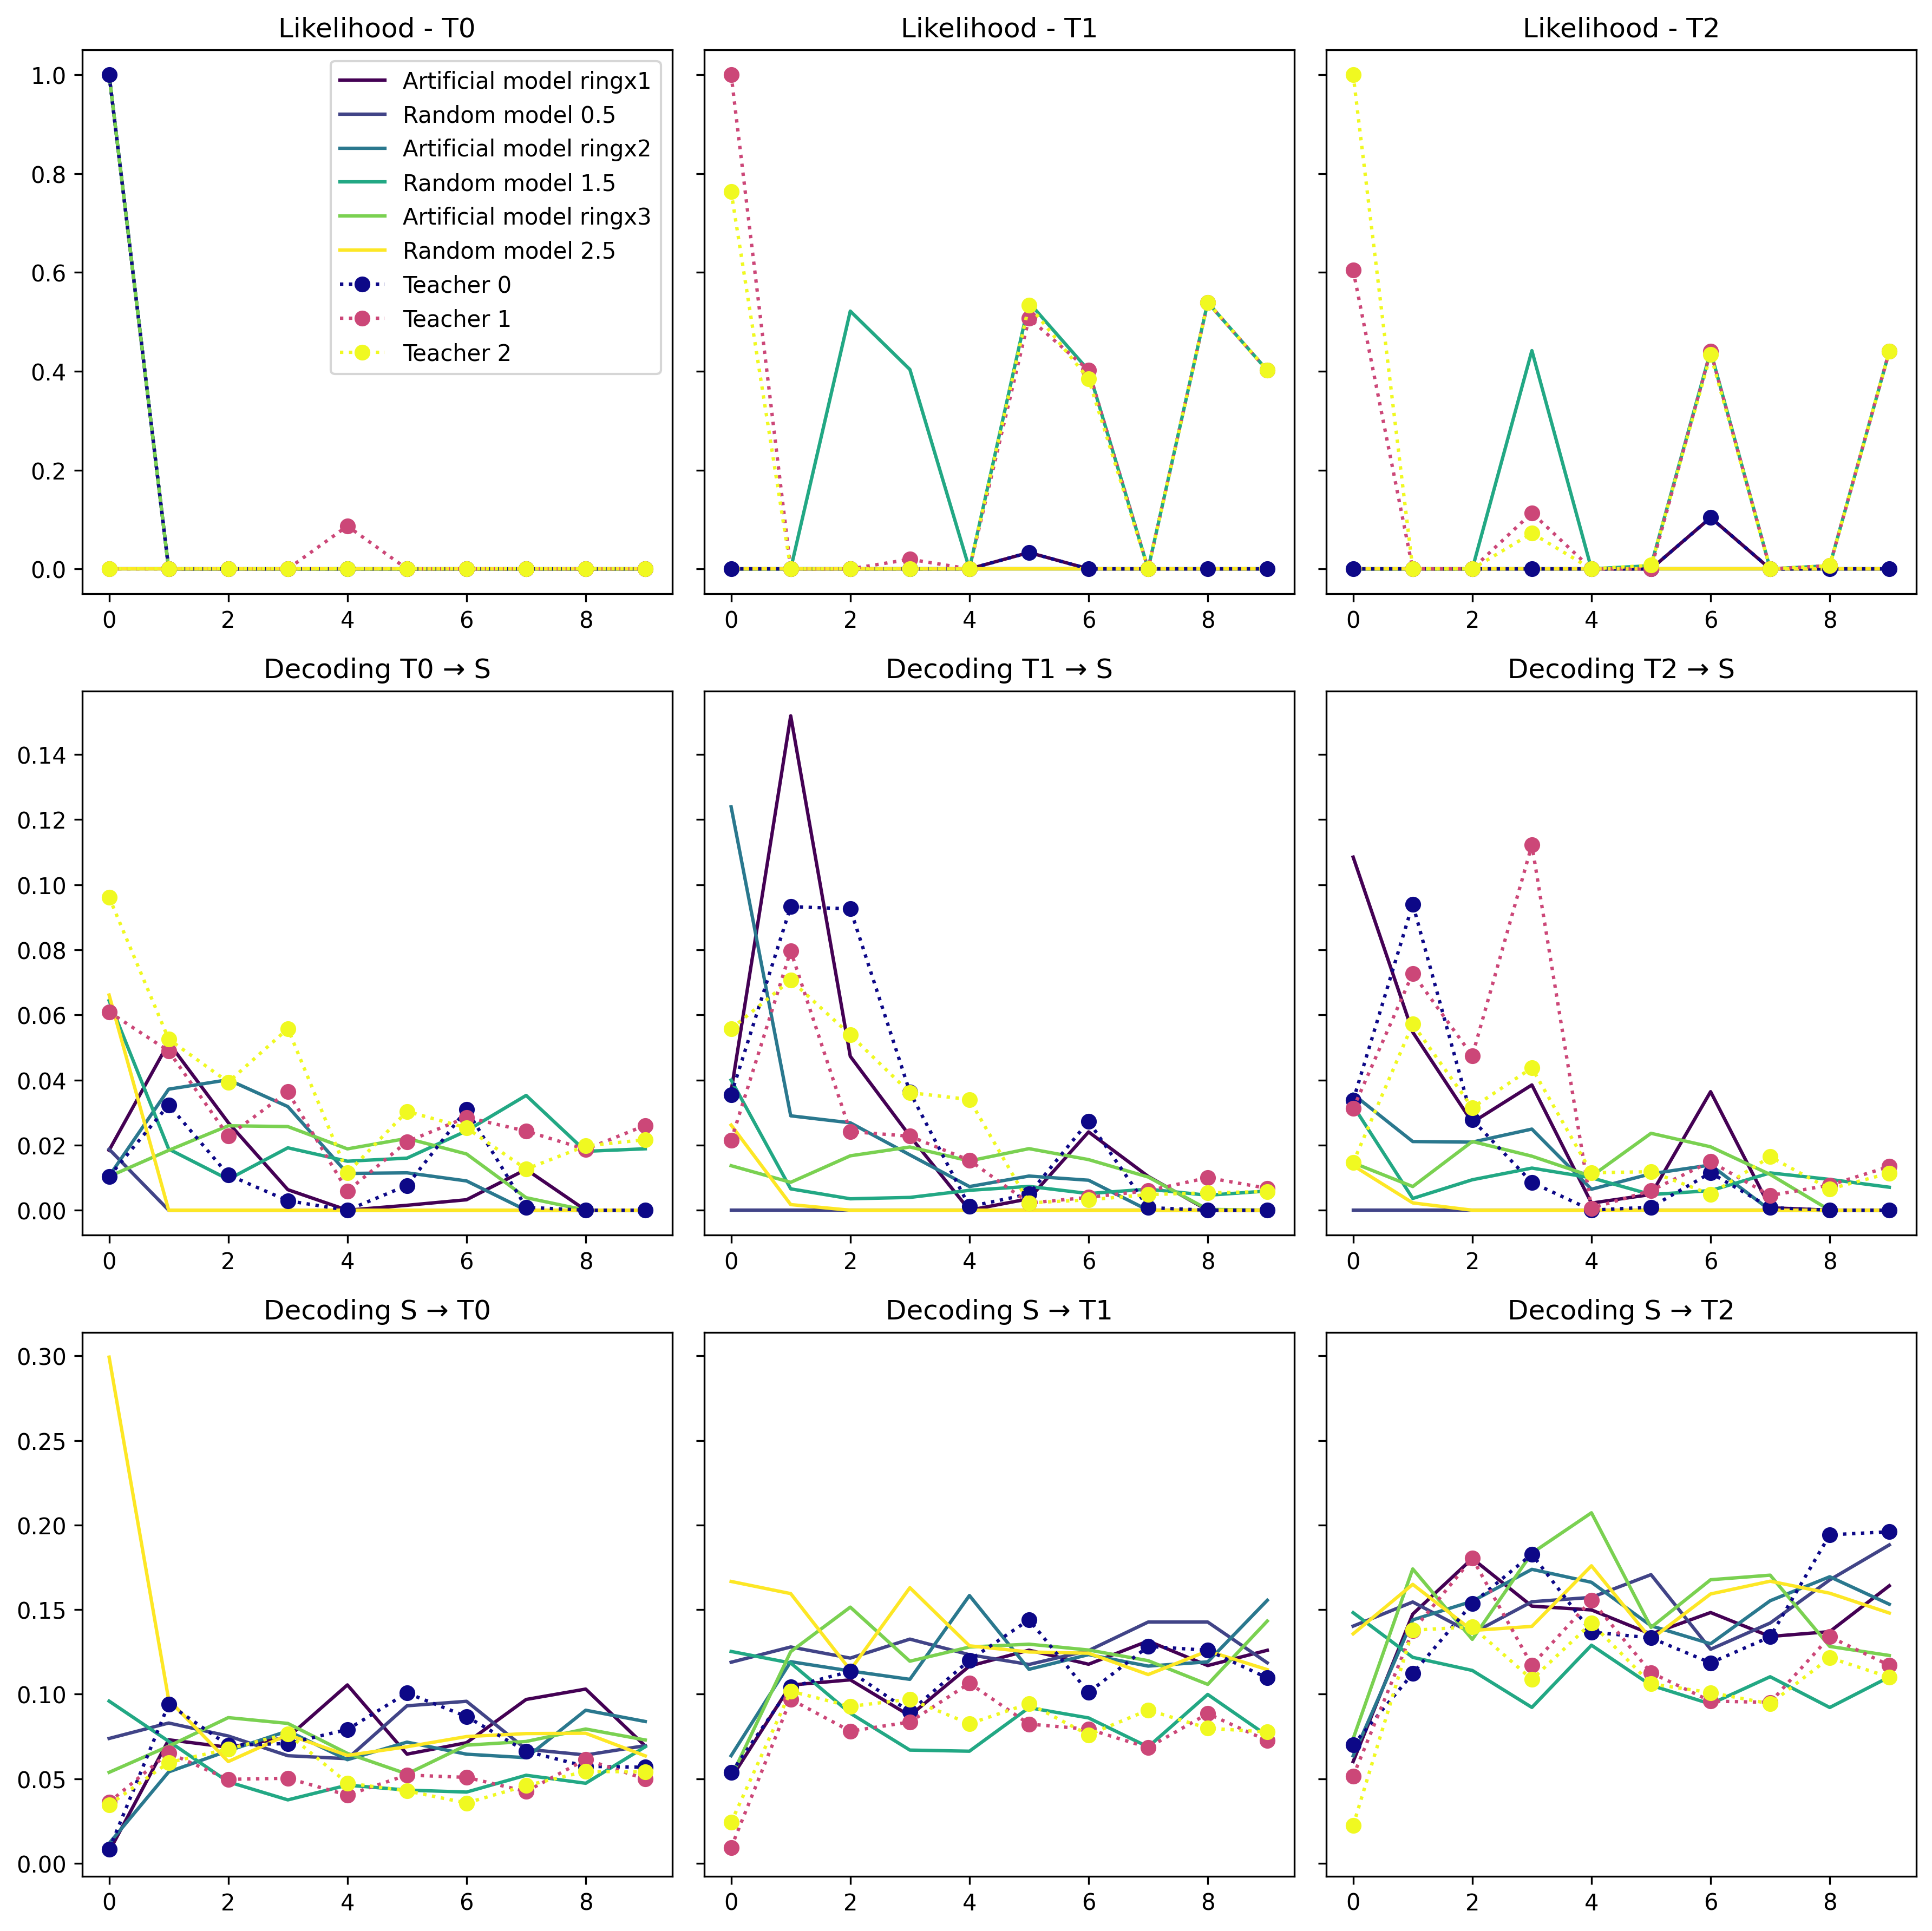
Zooming in + more tuning 10Epochs 15Iter 30Timesteps 10Trials
Notes:
*Here another unseen model does well (based on excel- yellow line.

Slide 31
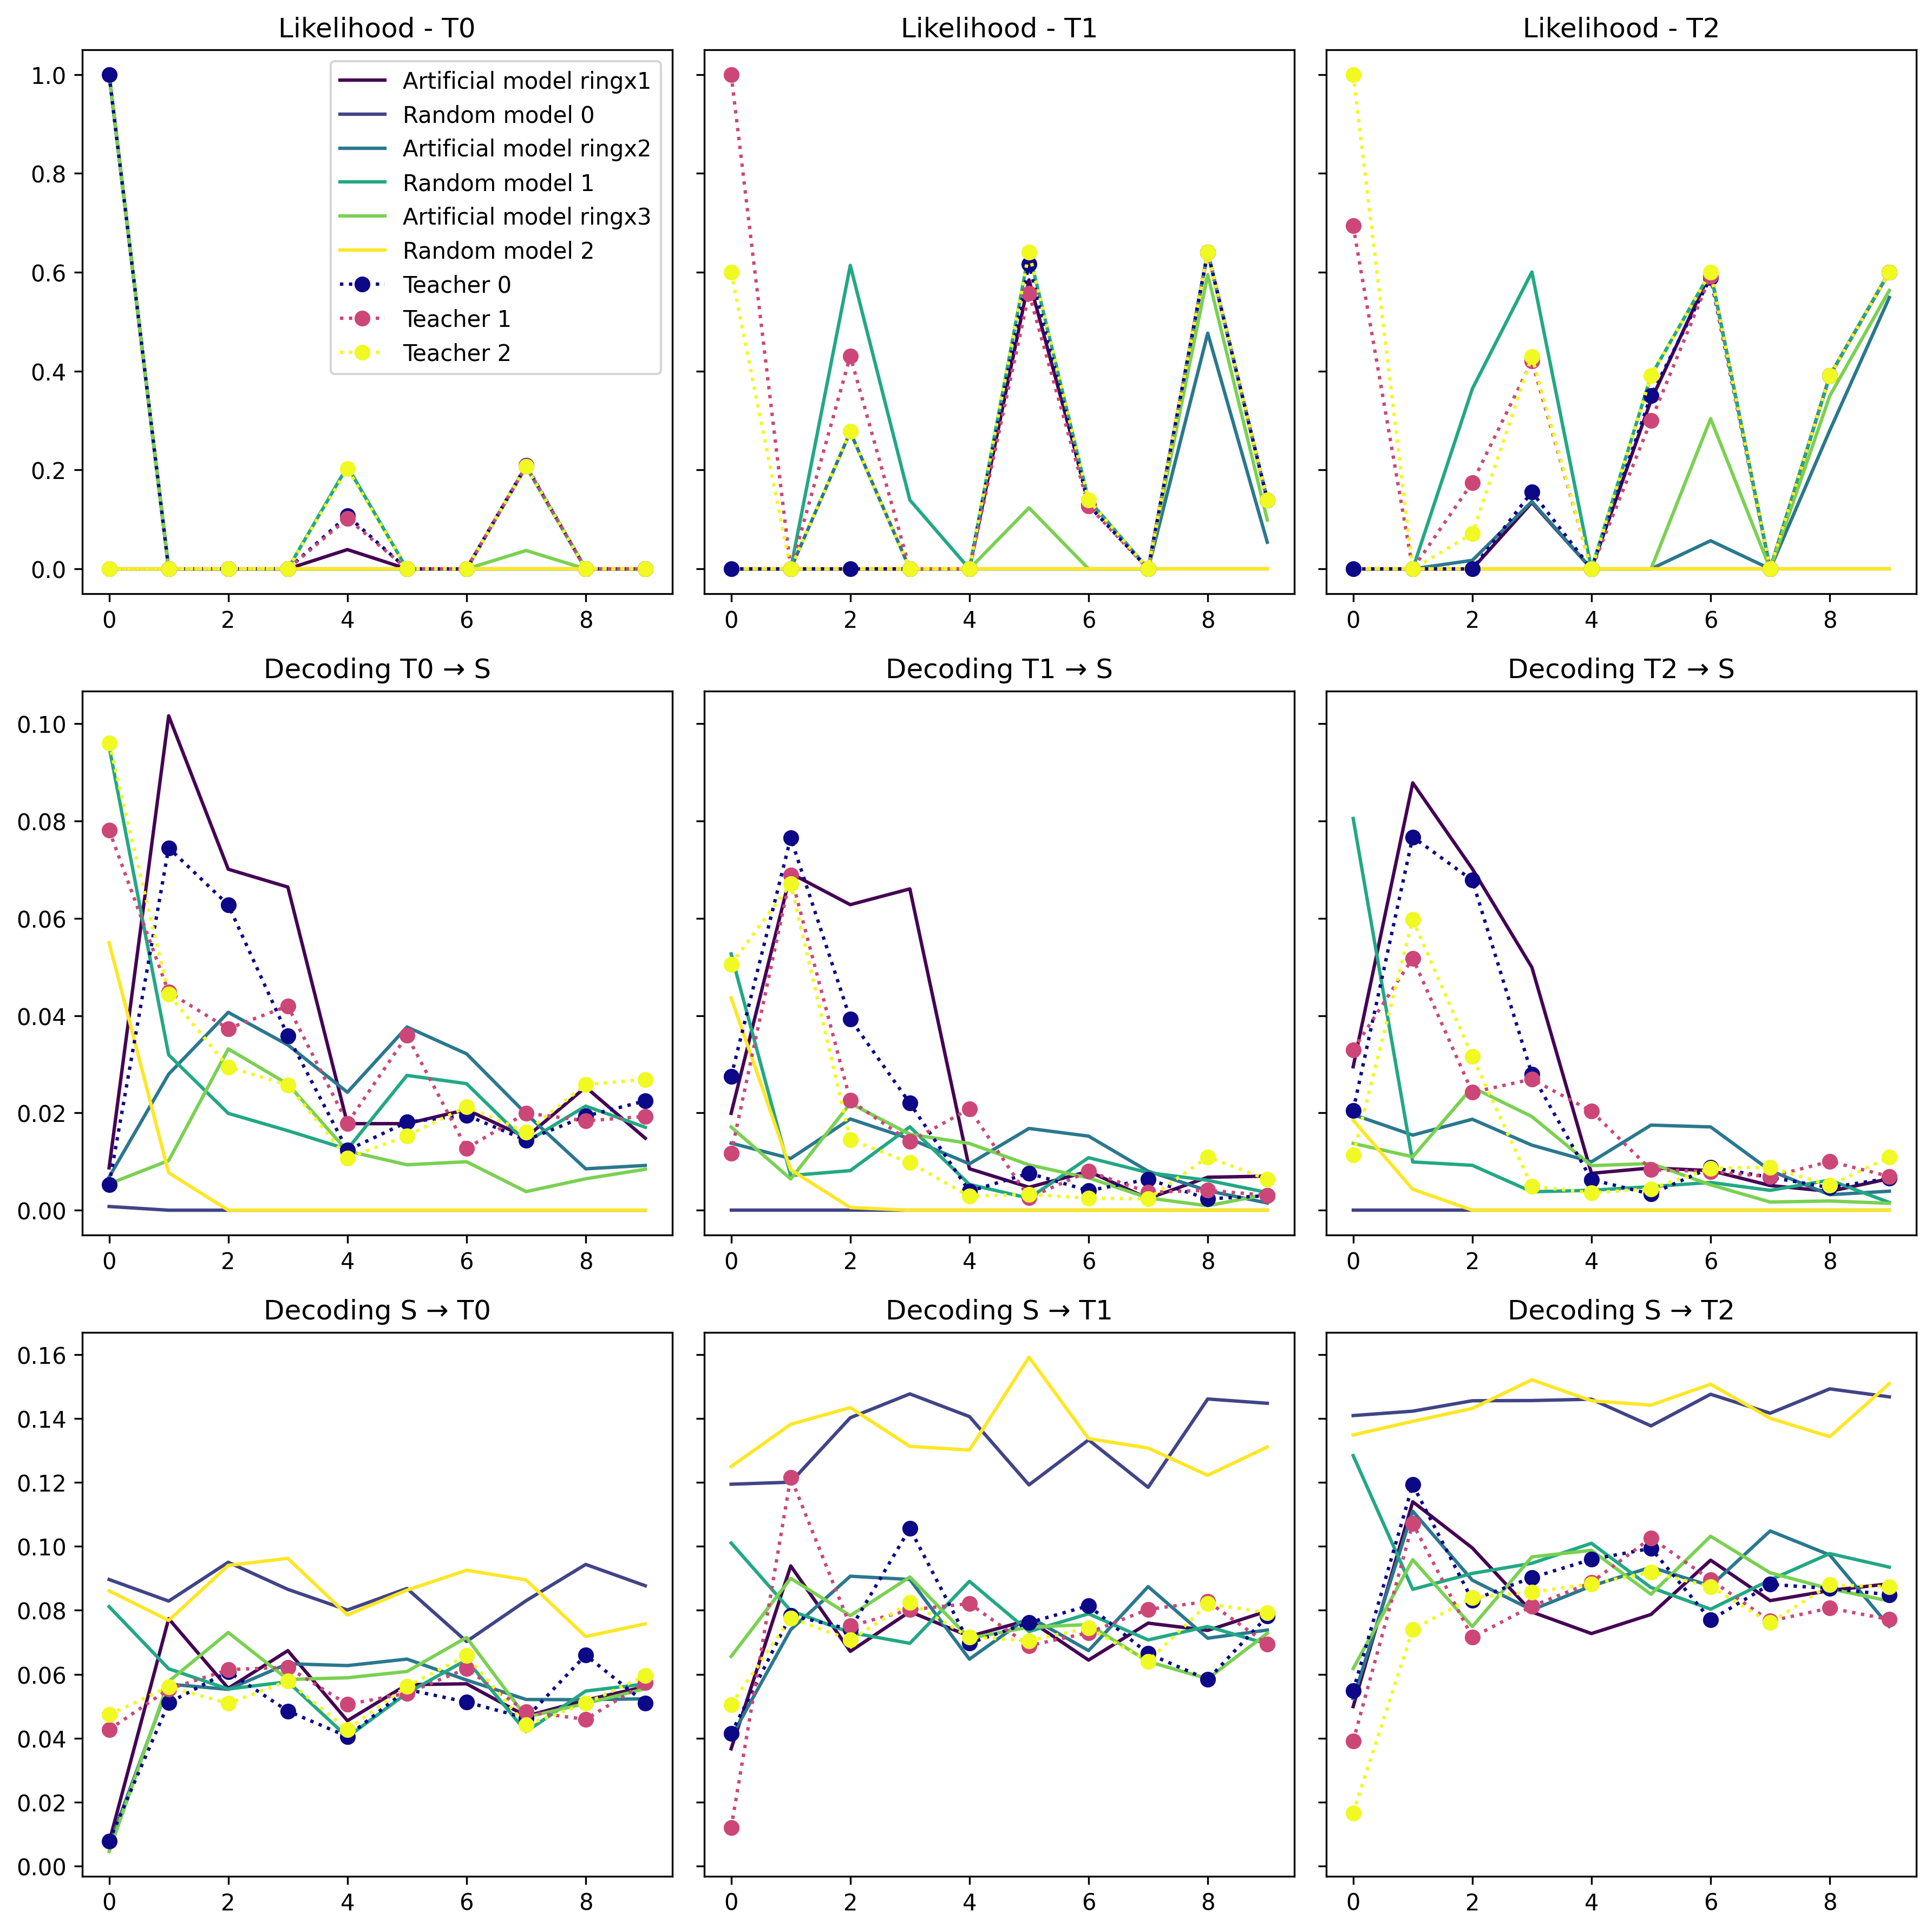
Even more tuning 10Epochs 15Iter 50Timesteps 10Trials
Notes:
The Turkoise line is a good model based on the decoding. So ghd

Slide 32
Does it make sense?
Likelihood shows us an overfitting right from the start for the artificial students and T0, which leads to a rise in the decoding error. Randomly initialized students, starting with poor performance, experience a rise in likelihood and a decrease as expected.
Artificial students decode T0 better than others, since they incorporate within them T0’s structure, but T0 doesn’t decode Artificial students well, as expected.
Last couple of graphs- not what I would’ve expected.

Slide 33
Conclusions
For the most part, the results aligned with the expectations, and the decoding graphs behaved as expected. Run with T0-fitted models that were fitted again for 20 Epochs tells us that if the perturbation is small enough (similar Ts), better results.
More data is needed (longer runs, more students and teachers…)
There are indicators that it takes more time for bigger models to adjust → they are filtered → a good sign because smaller more likely to be closer to the ground truth.
Not all students can be distinguished with this method*
Notes:
Bigger models have more parameters to optimize, so it takes longer for them to converge, so each epoch they lag behind, It’s good because if a model achieves high co-smoothing with small number of params, the closer it is to the ground truth if it has high co-smoothing
Not all students can be distinguished with this method* - all except 1. IDEA- combine methods? We can be as rigourous as possible

Slide 34
Challenges
There were many, but the major ones are:
Handling the HMM libraries (e.g. different syntax/problem with different functions and DEBUGGING…)
Remembering why I was doing whatever I was doing, and sometimes stopping, stepping backward, and trying a new approach.
Notes:
Then, perhaps, we’ll choose the likelihood over $T_{k}$ as one of the axes. For the other/s there are several options. One could be the highest likelihood each model had over any of the models (the detect if ”overfitting” helped), and a third one could simply be a discrete grid [1…k] representing the teacher’s num over which the likelihood of each model was the best.
Perturbations - (right now some of the perturbations are diagonal matrices)

Slide 35
Some ideas for the next steps
Use SGD and compare- especially transitions
Run with more students, teachers, etc.
On multi teacher- experiment with different hyper params (Iterations, etc.) – until a pattern is found?
Use few-shot instead of co-smoothing
Notes:
If I were to continue, these are my ideas, and open to change

Slide 36
Sources
Dabholkar, K., & Barak, O. (2024). When predict can also explain: Few-shot prediction to select better neural latents (arXiv:2405.14425). arXiv. http://arxiv.org/abs/2405.14425
Duncker, L., & Sahani, M. (2021). Dynamics on the manifold: Identifying computational dynamical activity from neural population recordings. Current Opinion in Neurobiology, 70, 163–170. https://doi.org/10.1016/j.conb.2021.10.014
Mathematical models of learning and what can be learned from them—PubMed. (n.d.). Retrieved August 4, 2024, from https://pubmed.ncbi.nlm.nih.gov/37043892/
Pei, F., Ye, J., Zoltowski, D., Wu, A., Chowdhury, R. H., Sohn, H., O’Doherty, J. E., Shenoy, K. V., Kaufman, M. T., Churchland, M., Jazayeri, M., Miller, L. E., Pillow, J., Park, I. M., Dyer, E. L., & Pandarinath, C. (2022). Neural Latents Benchmark ’21: Evaluating latent variable models of neural population activity (arXiv:2109.04463). arXiv. https://doi.org/10.48550/arXiv.2109.04463
https://neurallatents.github.io/
Stanford document about HMM Maybe:
Barak O. Recurrent neural networks as versatile tools of neuroscience research. Curr Opin Neurobiol. 2017 Oct;46:1-6. doi: 10.1016/j.conb.2017.06.003. Epub 2017 Jun 29. PMID: 28668365.

